Slide 1
The SRH Needs of Africa’s Young People
Christelle Kwizera, 19
Rwanda
“Africa’s growing youth population comes with
high energy, creativity, and talents which are key to future prosperity”
Notes:
Young people make up the majority of the world’s population, with about 50% of the world being under the age of 25. Policies affecting the youth right now are affecting tomorrow’s Africa. Africa’s young population constitutes its greatest asset. It holds the potential for Africa’s renaissance. However, as we look at the great potential that is in this young population, of which I am a proud member, it is important that our needs be considered--especially our Sexual and Reproductive Health or SRH needs. Successful policy is one that considers the voice of those affected directly by the policy. Therefore, it is an honor to be here representing the youth and giving a youth perspective on how to best address the SRH needs of Africa’s young people.

Slide 2
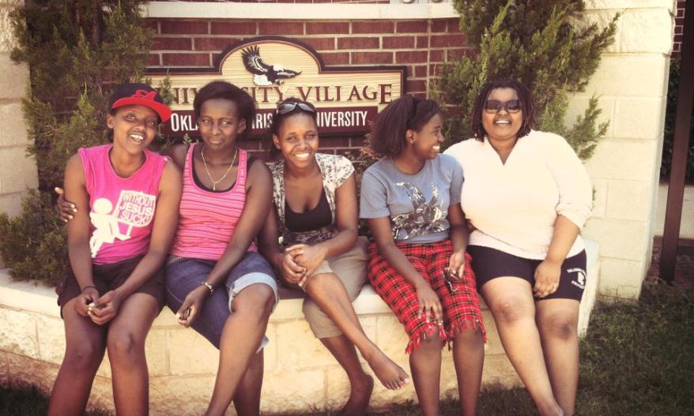
Rwandan Scholars at Oklahoma Christian University during the Annual Emerging Leaders and Entrepreneurs of Rwanda Summit.
Notes:
I am just 19. While I do not have as much education and experience as many in my audience, in the 19 years I have lived, I have seen what a difference full access to Reproductive health information and preventive services can make. We are living in a rapidly changing world, and I am experiencing it as a young woman, going into adulthood. Like many girls in Rwanda, I went through a class that covered reproductive health. While we were taught how babies are made and the advantages of family planning, the methods of FP and where to get services were left out of the class. The class did not teach us life skills – it was just another quiz to pass or fail. In a society where talking about sex is taboo, that class was probably the only discussion many of my peers would have for a long time.
I, on the other hand, was blessed with a mother who knew quite a lot on RH and was very open with answering my questions as well as providing me with booklets full of answers to the questions I dared not ask. Still I watched two of my childhood friends struggle with unintended pregnancy and miss out on educational opportunities. We were told to use condoms by billboards on roads, However we did not know where to get them and would have been too embarrassed to buy some from the store. After all, the store was run, by your uncle, a friend of your mom or a church acquaintance.

Slide 3
Unmet SRH Needs
20,000 girls give birth every day in developing countries
70,000 adolescent deaths annually from complications from pregnancy, childbirth
3.2 million unsafe abortions among adolescents each year
Notes:
Currently, Unintended Pregnancies affect the African Youth on a large scale and they are the most visible consequence of unmet SRH needs. 20,000 girls give birth every day in developing countries, and many of these pregnancies are unintended. There are 70,000 adolescent deaths annually from complications from pregnancy, childbirth and 3.2 million unsafe abortions happen among adolescents each year.
It is imperative to our success as young people and that of our nations that this problem be addressed.

Slide 4
Leading Causes of Unintended Pregnancy
Child marriage
Gender inequality
Lack of access to education and SRH services
Obstacles to human rights
Poverty
Sexual violence
National policies restricting access to contraception and sexuality education
Underinvestment in adolescent girls’ human capital
Notes:
Unintended pregnancies are the root of many young people’s unfulfilled potential and missed opportunities. Here on the slide I have listed some of the leading causes of Unintended Pregnancy. A few of these are directly within your power to change, to cite some: Lack of access to education and SRH services, National Policies that restrict access to contraception and underinvestment in adolescent girl’s human capital. In my personal experience, the power of a dream and the hope in a bright future, and the belief that those can be attained, are very powerful preventive tools. They stand behind a young person’s ability to make smart choices regarding their reproductive health. A recent UNFPA publication makes the same argument, stating that “Girls who lack choices and opportunities in life, who have limited or no access to SRH… are most likely to become pregnant.”

Slide 5
Consequences of Unintended Pregnancy
Stigma
Maternal and newborn health
Cycle of poverty
School drop-out
Economic loss for nation
"Prospects are brighter for a girl who is healthy, educated and able to enjoy rights."
Notes:
But what does really happens to a girl who faces an unintended pregnancy? Stigma and rejection are common reactions from communities who blame the pregnancy on the girl. Most girls lose out on educational opportunities, and there are consequences for her health and for her child. This perpetuates the cycle of poverty for these girls, and on a national level, it affects the economy as fewer girls can reach their potential and contribute to economic growth. But mostly, the whole world is missing out on the creative power of the young woman who falls of the grid due to an unintended pregnancy.

Slide 6
Policy Successes
Reduced minimum age for contraceptives
Including CSE in national curriculum
Multi-sectoral approach to youth policy including SRH
National guidelines for youth-friendly services
Notes:
So what can we do? What can you as policy makers do to insure all young people’s potential go fulfilled? Here are some examples of recent policy successes from countries in Africa. SA reduced the minimum age for access to contraceptives to 12, Namibia and Zambia got Comprehensive Sexual Education in their national curriculum. Malawi and Zambia have drafted national guidelines for youth friendly services. To top it off, Senegal adopted a Multi-sectorial approach to youth policy that uses SRH components.

Slide 7
Components of Successful Programs
Make use of new media
Integrated approach
Developed by youth or with youth input
Focus on skill building and mentorship
Youth-friendly and community based
Notes:
In addition to policies, we can learn from many successful programs throughout Africa. Some of the components that make them successful are offering job trainings in addition to cheap health care, using peer assisted trainings and young people to promote and distribute condoms on a community level, and offering mentorship and career guidance in addition to SRH services. These programs do not just provide information but make knowledge of SRH a life-skill for the young people they serve. By drawing on popular media and By meeting the more obvious needs of the youth such as unemployment and skill building, these programs are able to address SRH is ways that are meaningful for youth and help them build skills.

Slide 8
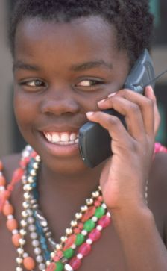

Potential of Technology
Cost-effective
Available 24/7
Broad reach
Anonymous
Photo Credit: Daily mail
Notes:
As we consider addressing the needs of the current and upcoming generation of young people, I personally believe in using technology and partnering with youth initiatives. Nowadays, young people spend a lot of hours on the internet. Either at Cyber Cafes or through their phones. The mobile phone ownership is only projected to increase with phones being made cheaper each day. According to the world bank, in some African countries more people have access to a mobile phone than to clean water, a bank account, or electricity. New technologies offer a great way to communicate quality information 24/7. It is cost effective, confidential and has the potential to reach a lot of people considering mobile phone ownership is high and on the rise in Africa.

Slide 9
Working with Youth Initiatives
Overcome social and cultural barriers
Community and grassroots efforts
Innovative solutions to social challenges
Tap into existing social networks
Notes:
It is easy to overlook certain cultural and societal barriers, but partnership with civil societies, citizens groups and particularly youth-led initiatives can overcome this and is essential to the success of policy regarding SRH. Youth initiatives all throughout Africa have tackled issues such as social injustice, illiteracy, water crisis and they have helped advance their countries through promoting the use of technology, and advocacy networks. I know from my experiences that many youth have innovative solutions to local challenges, and are eager to be part of the solutions across the continent. Homegrown solutions and self-reliance is the new motto of this generation. And research has shown that youth participation makes programs much more successful. Working with already existing youth-initiatives and adding an SRH component to their agenda, is a proven way to advance SRH knowledge especially among the already active youth and networks of their programs.

Slide 10
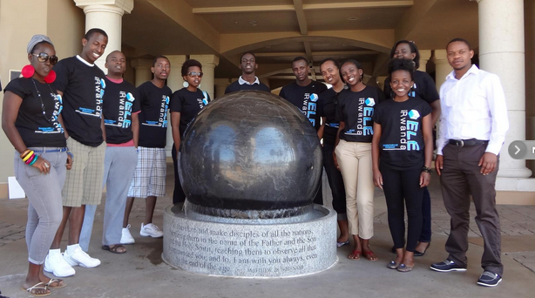
Truly Investing In Youth
Job creation
Supporting the youth to make positive choices
Mentorship and skill building
Full access to SRH services
Notes:
As policy is being drafted, we must remember it is both for the youth now, some of whom are already young parents, and the youth transitioning into adulthood. When you ask a young person what is the main challenge they face right now, most will answer unemployment. There is a huge need for job creation. Young people are full of energy and full of dreams, ambitions and goals. Truly investing in the youth means making it a reality that those goals can be achieved. A critical part of that is the responding to our SRH needs and providing youth with the skill and mentorship to avoid the consequences of unintended pregnancies. We need to be granted FULL ACCESS to family planning and SRH services. If they are supported to make positive choices, the youth of Africa today can contribute to development in our countries in unprecedented ways. Thank you for your attention, and I look forward to hearing your discussion.

