Slide 1


A slide deck on the demographic dividend from PRB

Slide 2
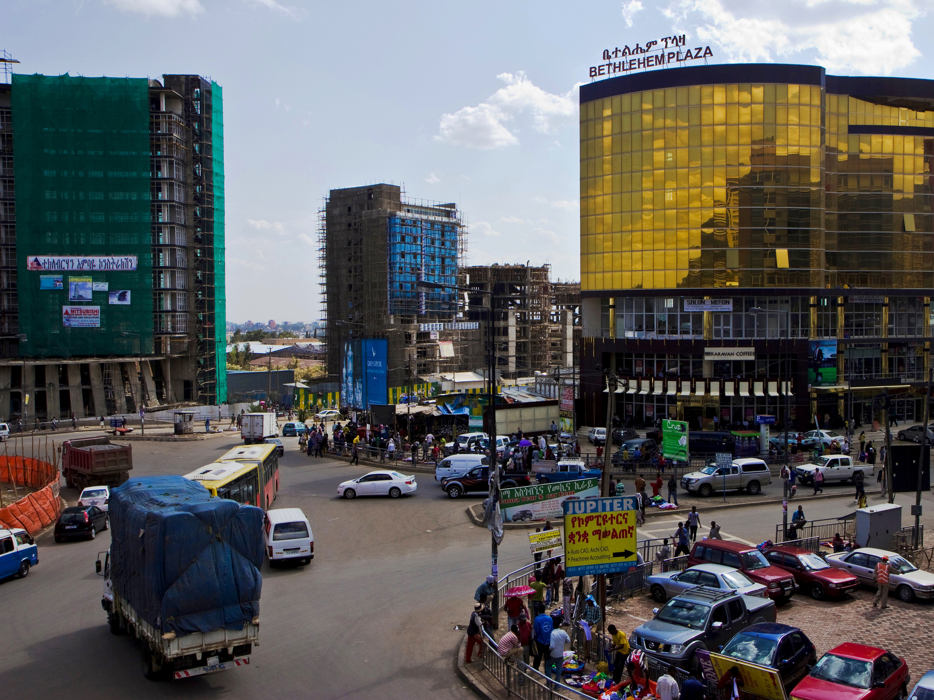
The demographic dividend is the accelerated economic growth that may result from a rapid decline in a country’s fertility.

Slide 3
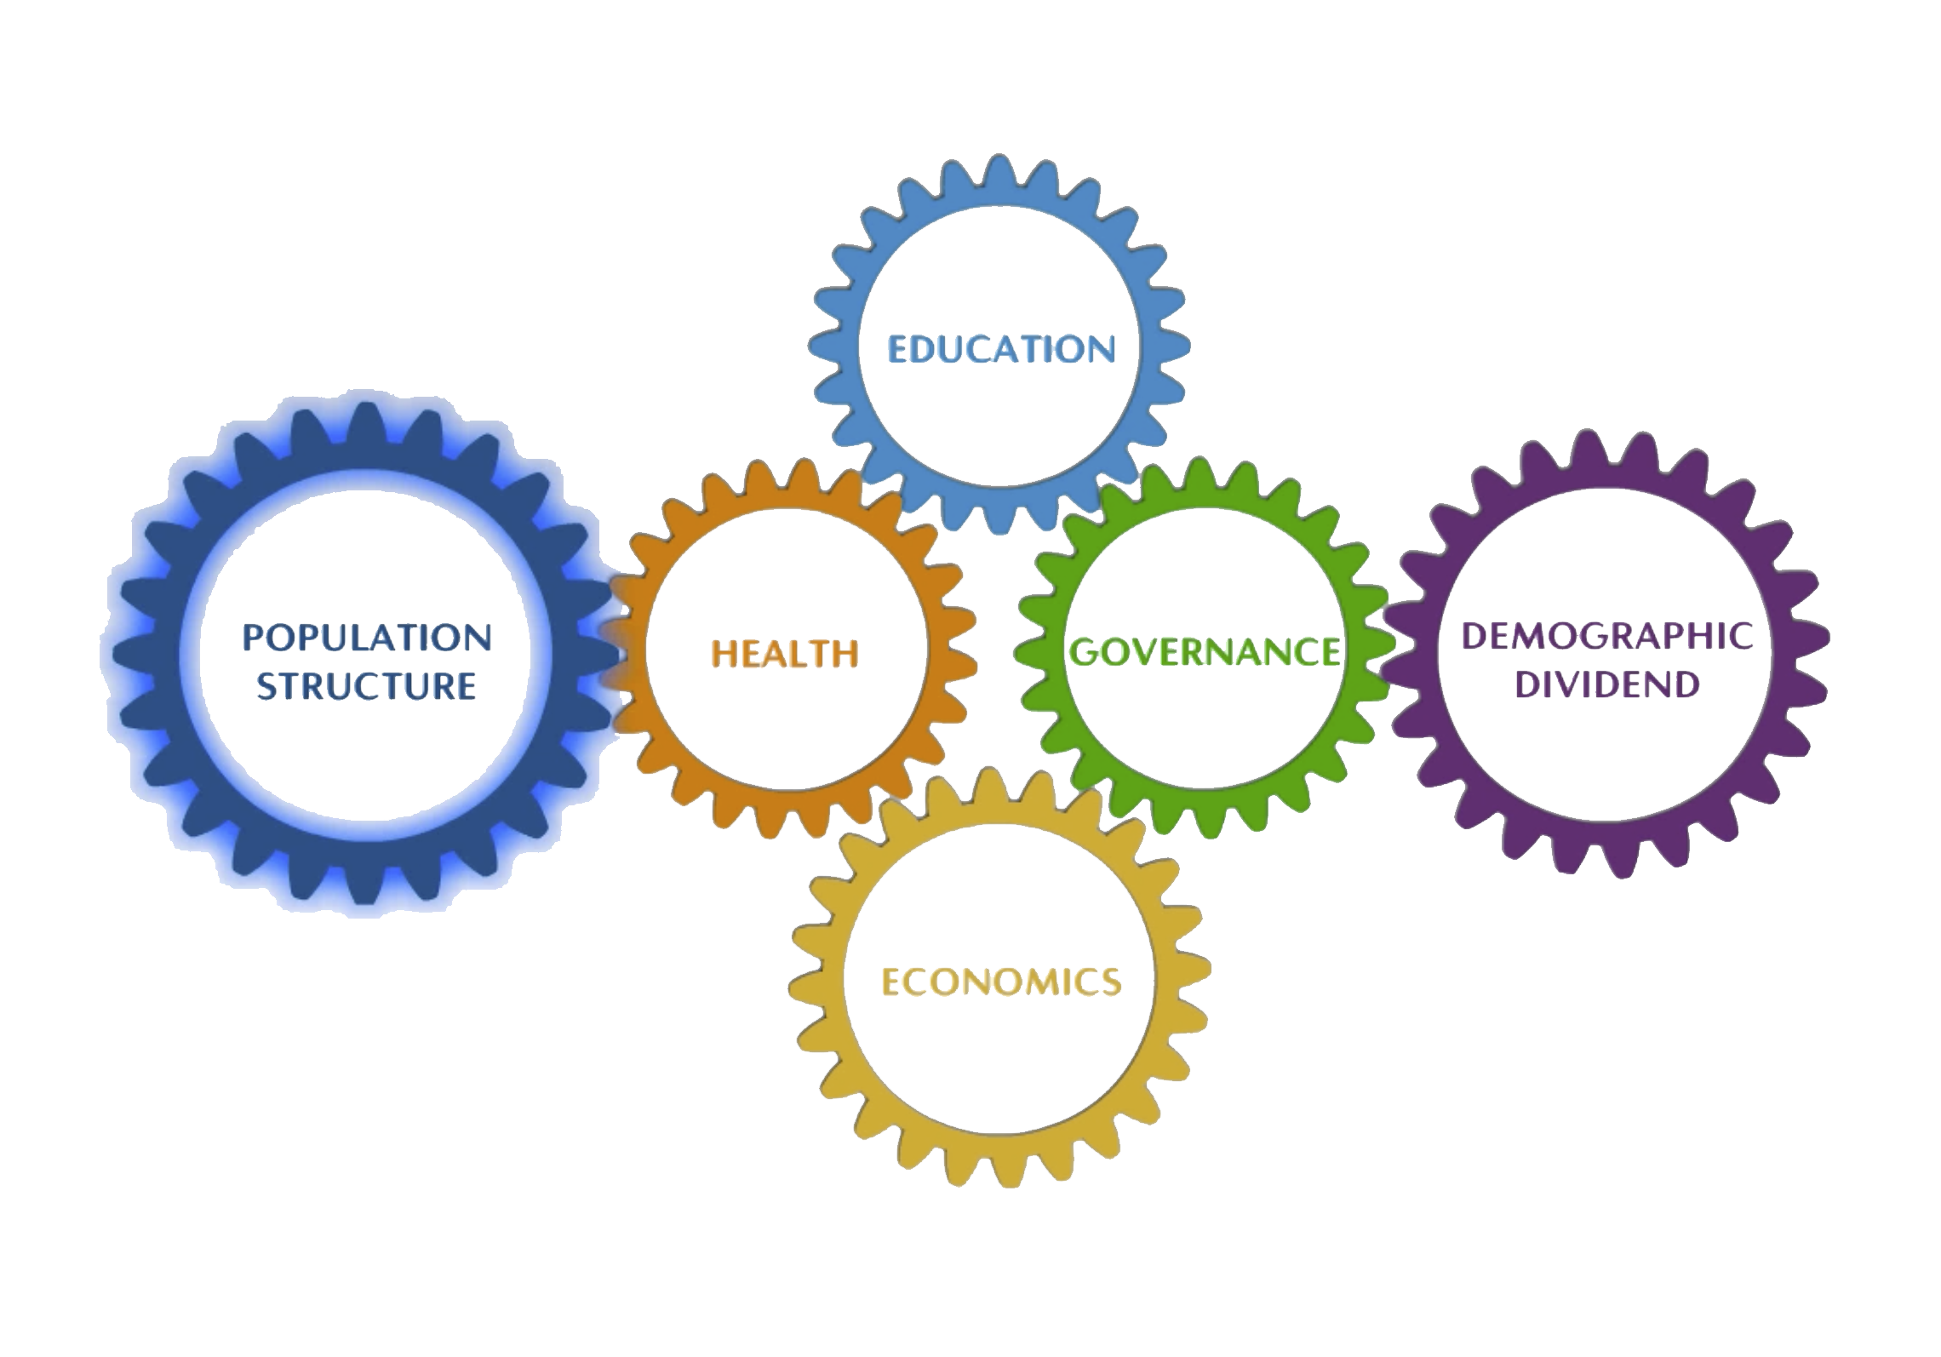

Slide 4
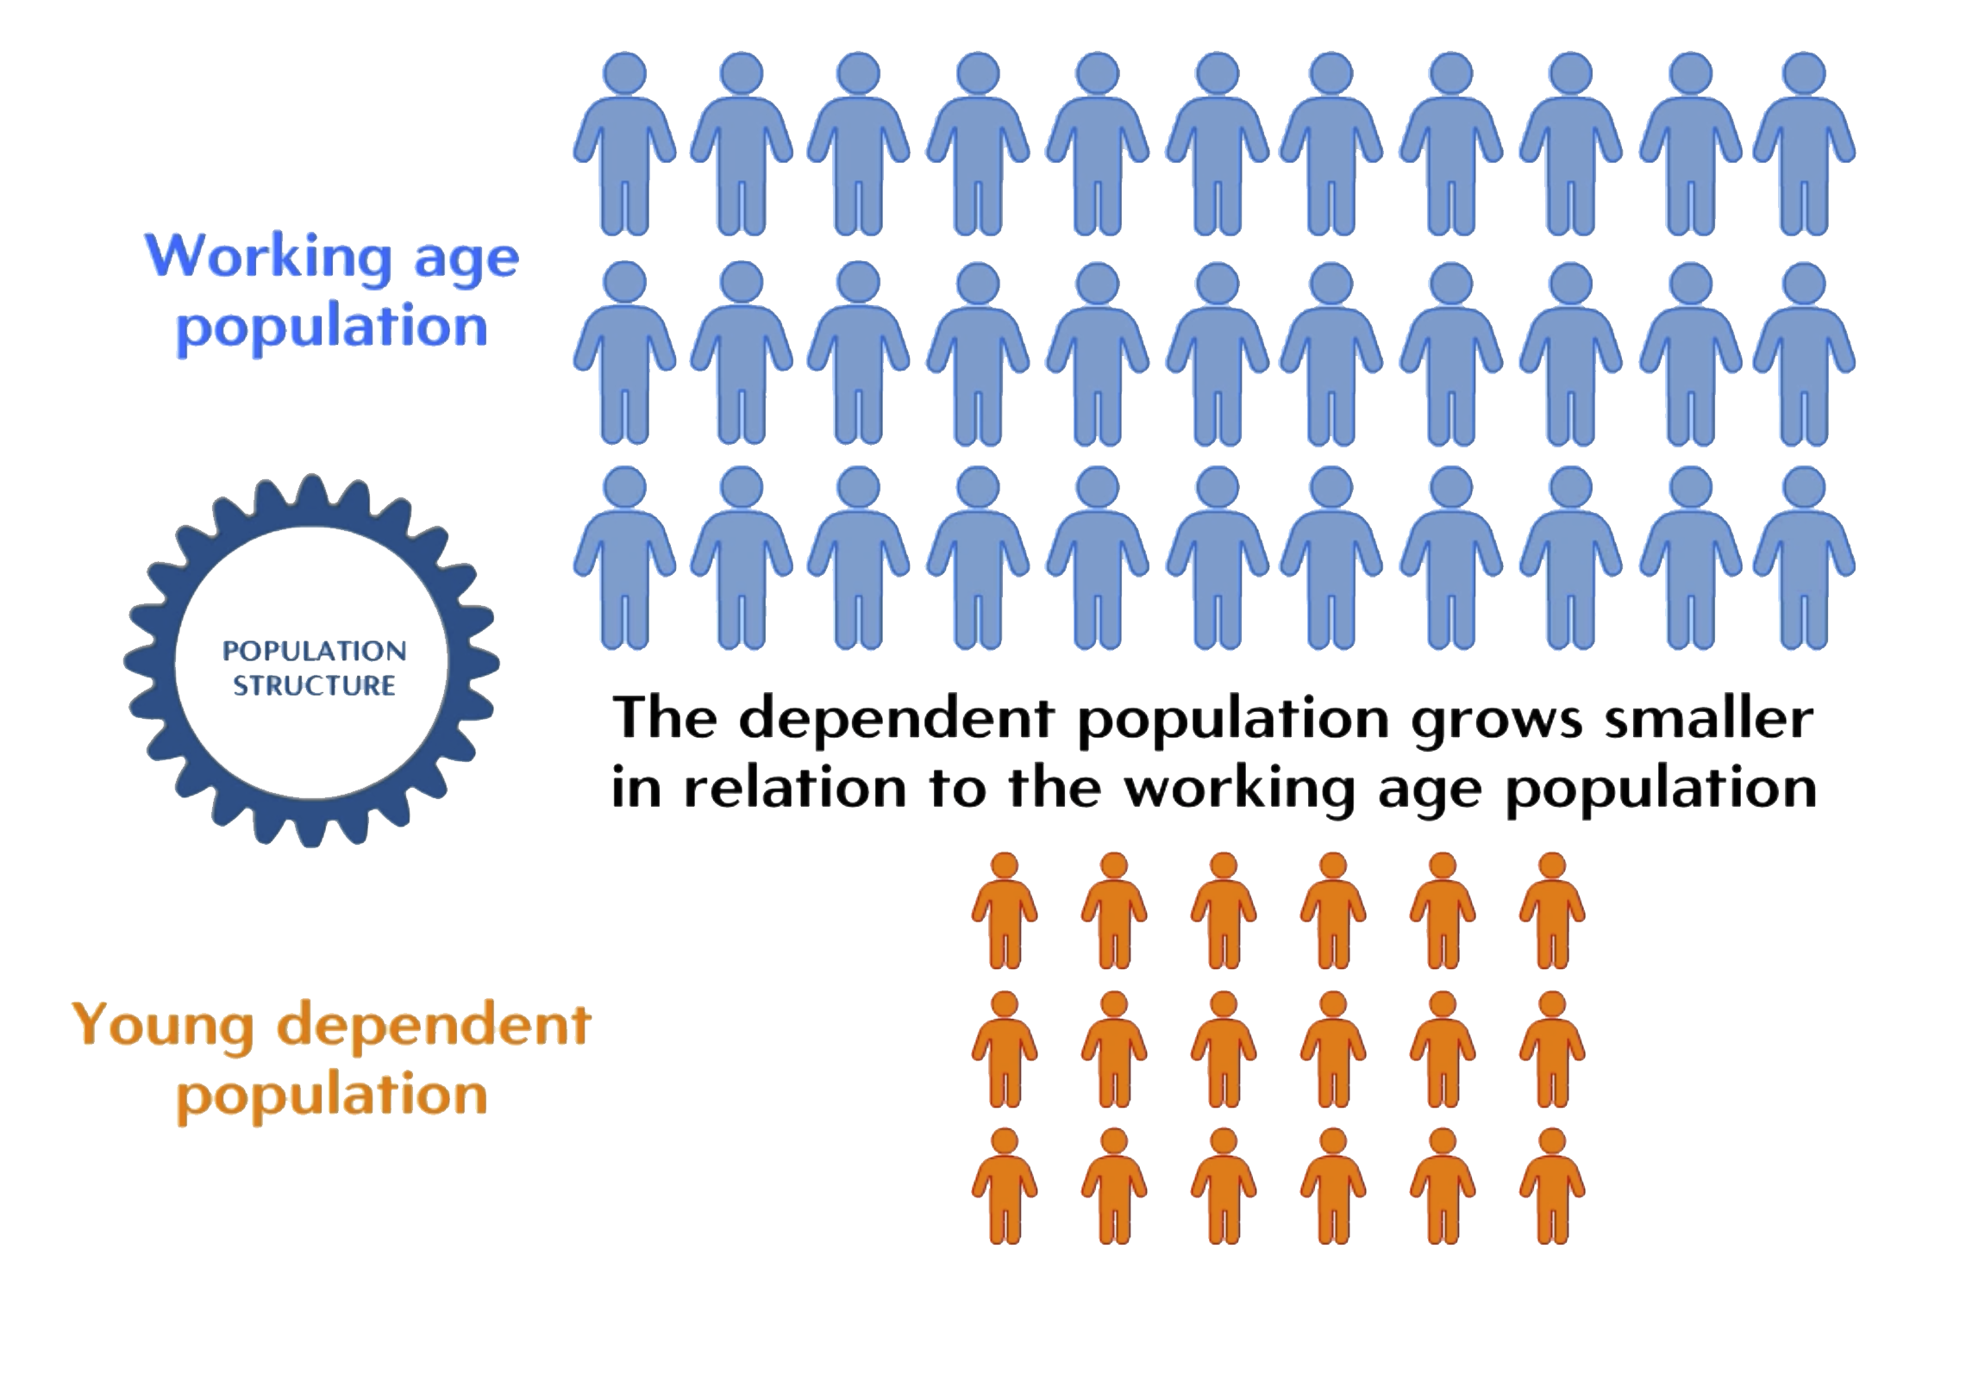

Slide 5


Key investments are necessary to lower fertility, and mortality, and allow the population structure to change

Slide 6

A healthy population contributes to a demographic dividend

Slide 7


Slide 8
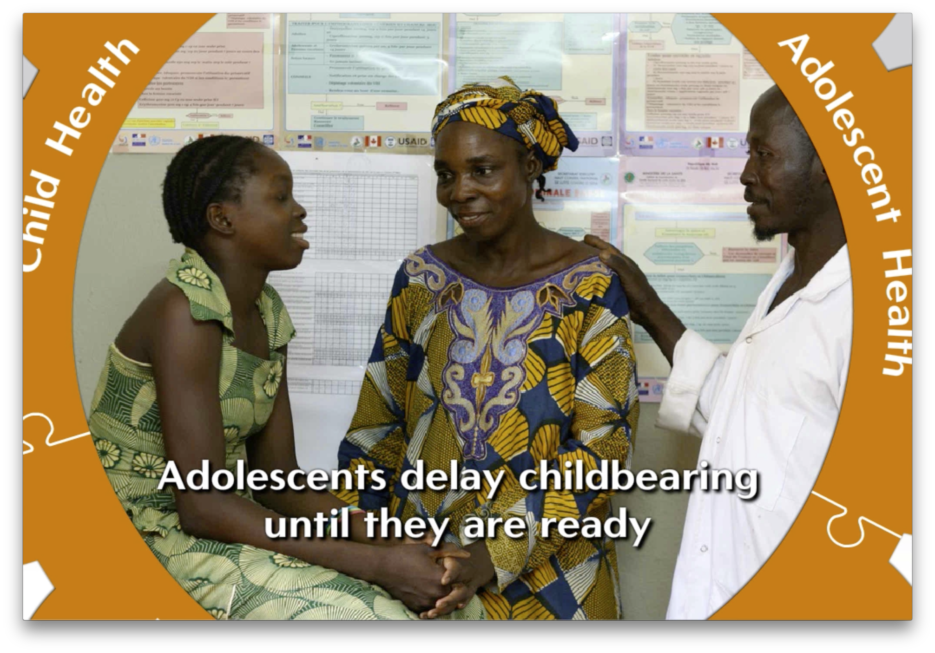

Slide 9


Slide 10


Slide 11

Investments in education are critical for a demographic dividend

Slide 12


Slide 13


Slide 14
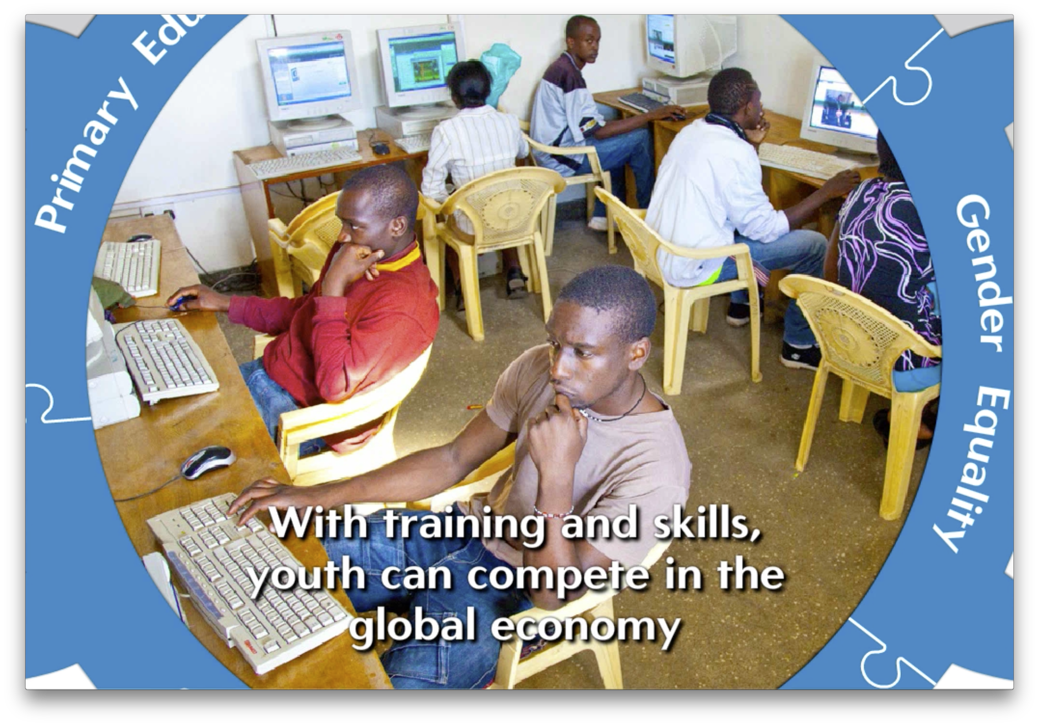

Slide 15
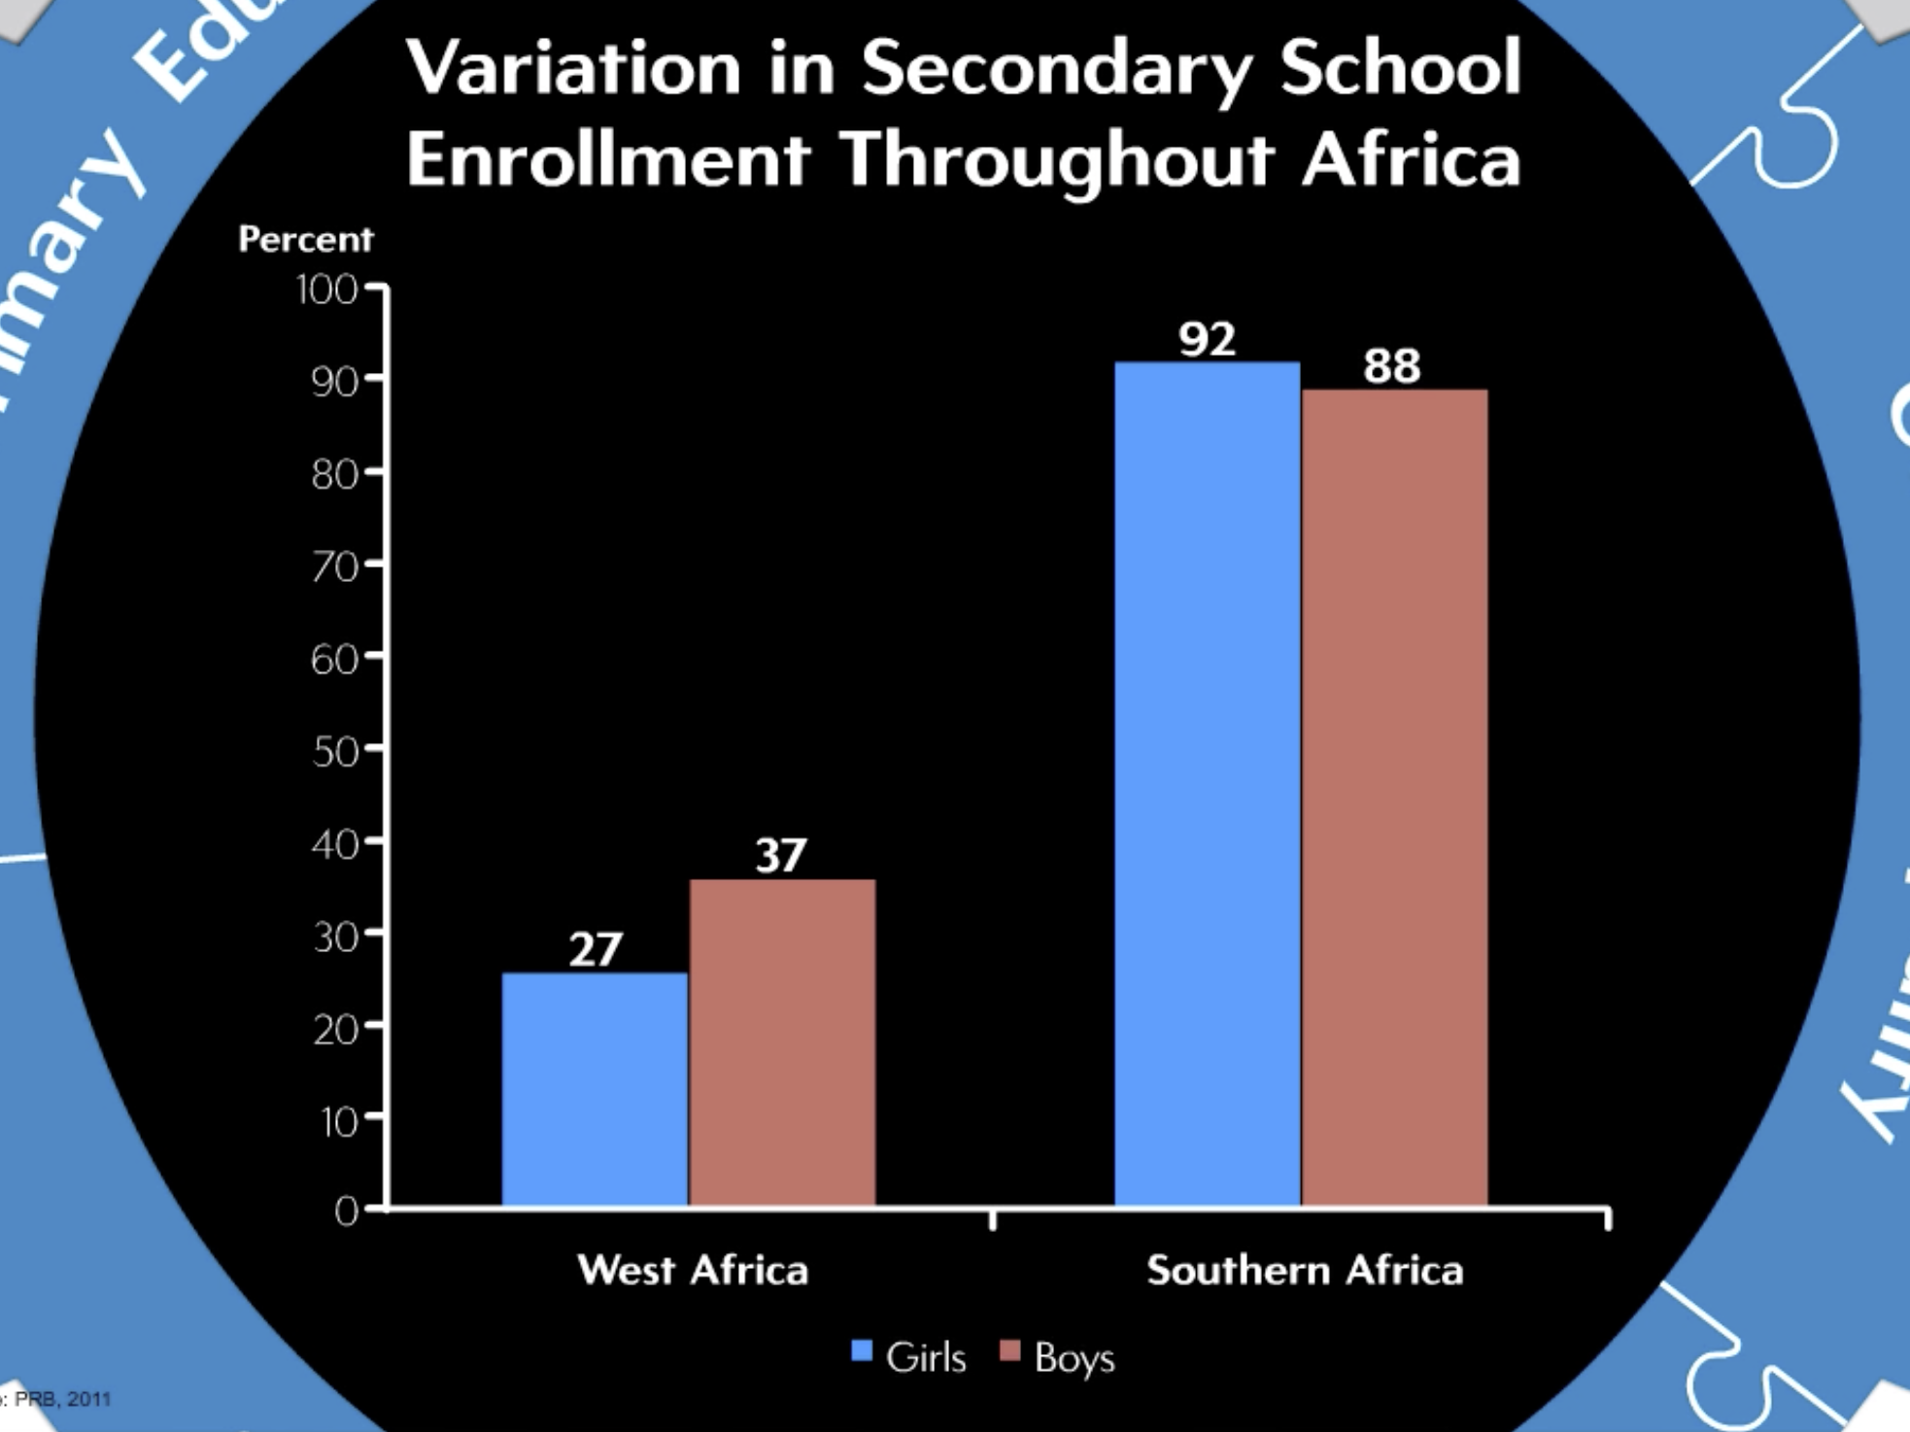

Slide 16

Supportive economic policies to harness a demographic dividend

Slide 17
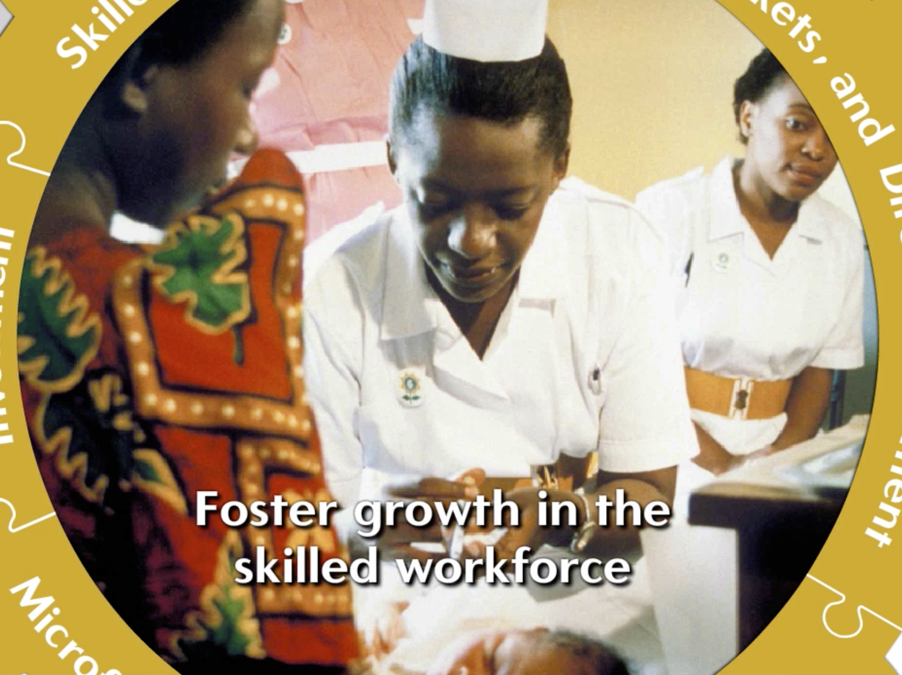

Slide 18
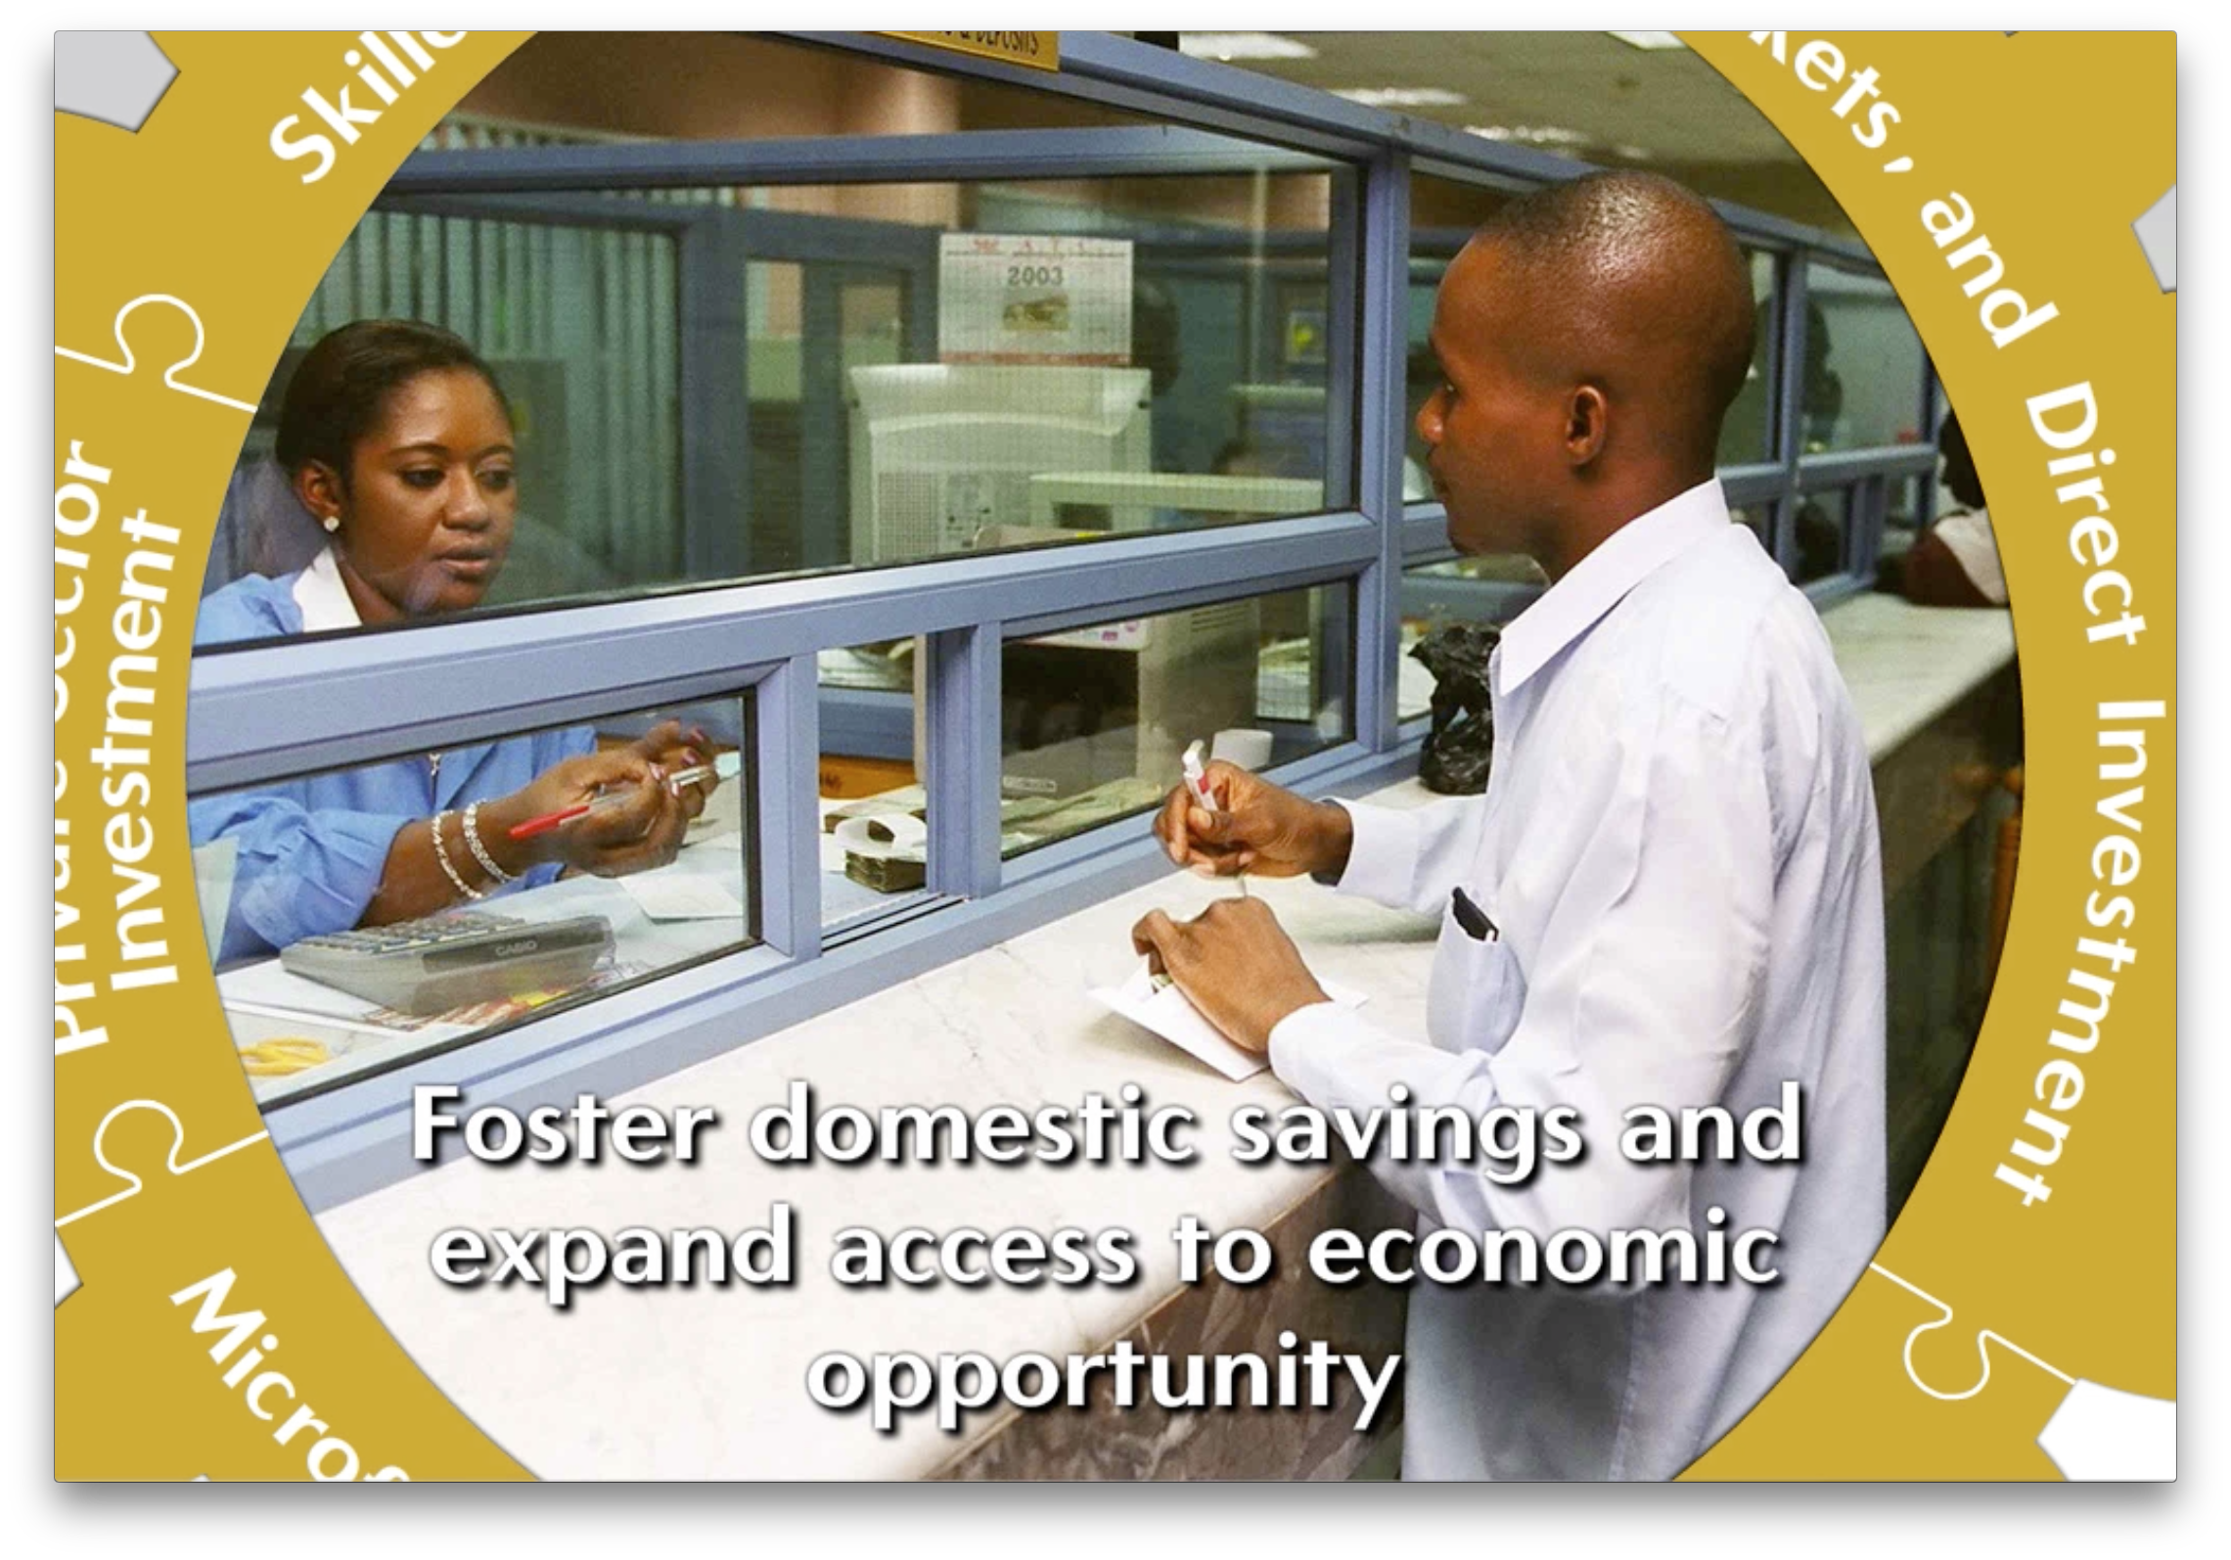

Slide 19

Good governance practices provide a foundation for a demographic dividend

Slide 20


Slide 21


Slide 22
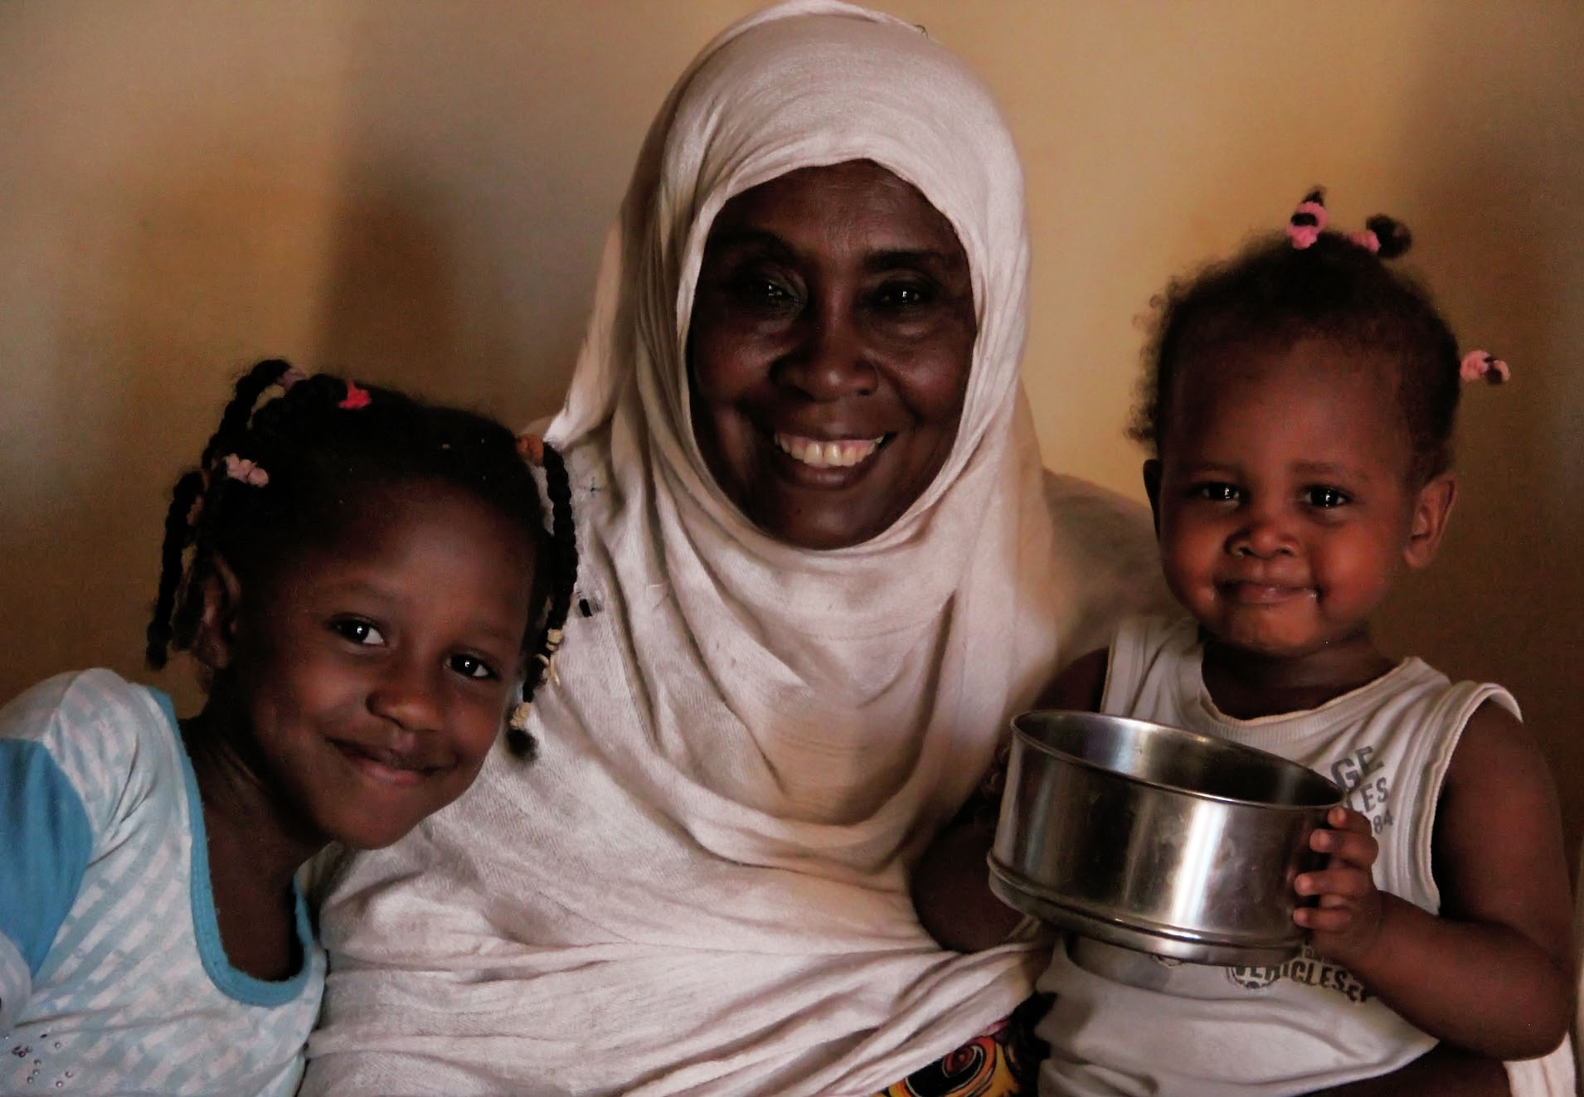

Slide 23
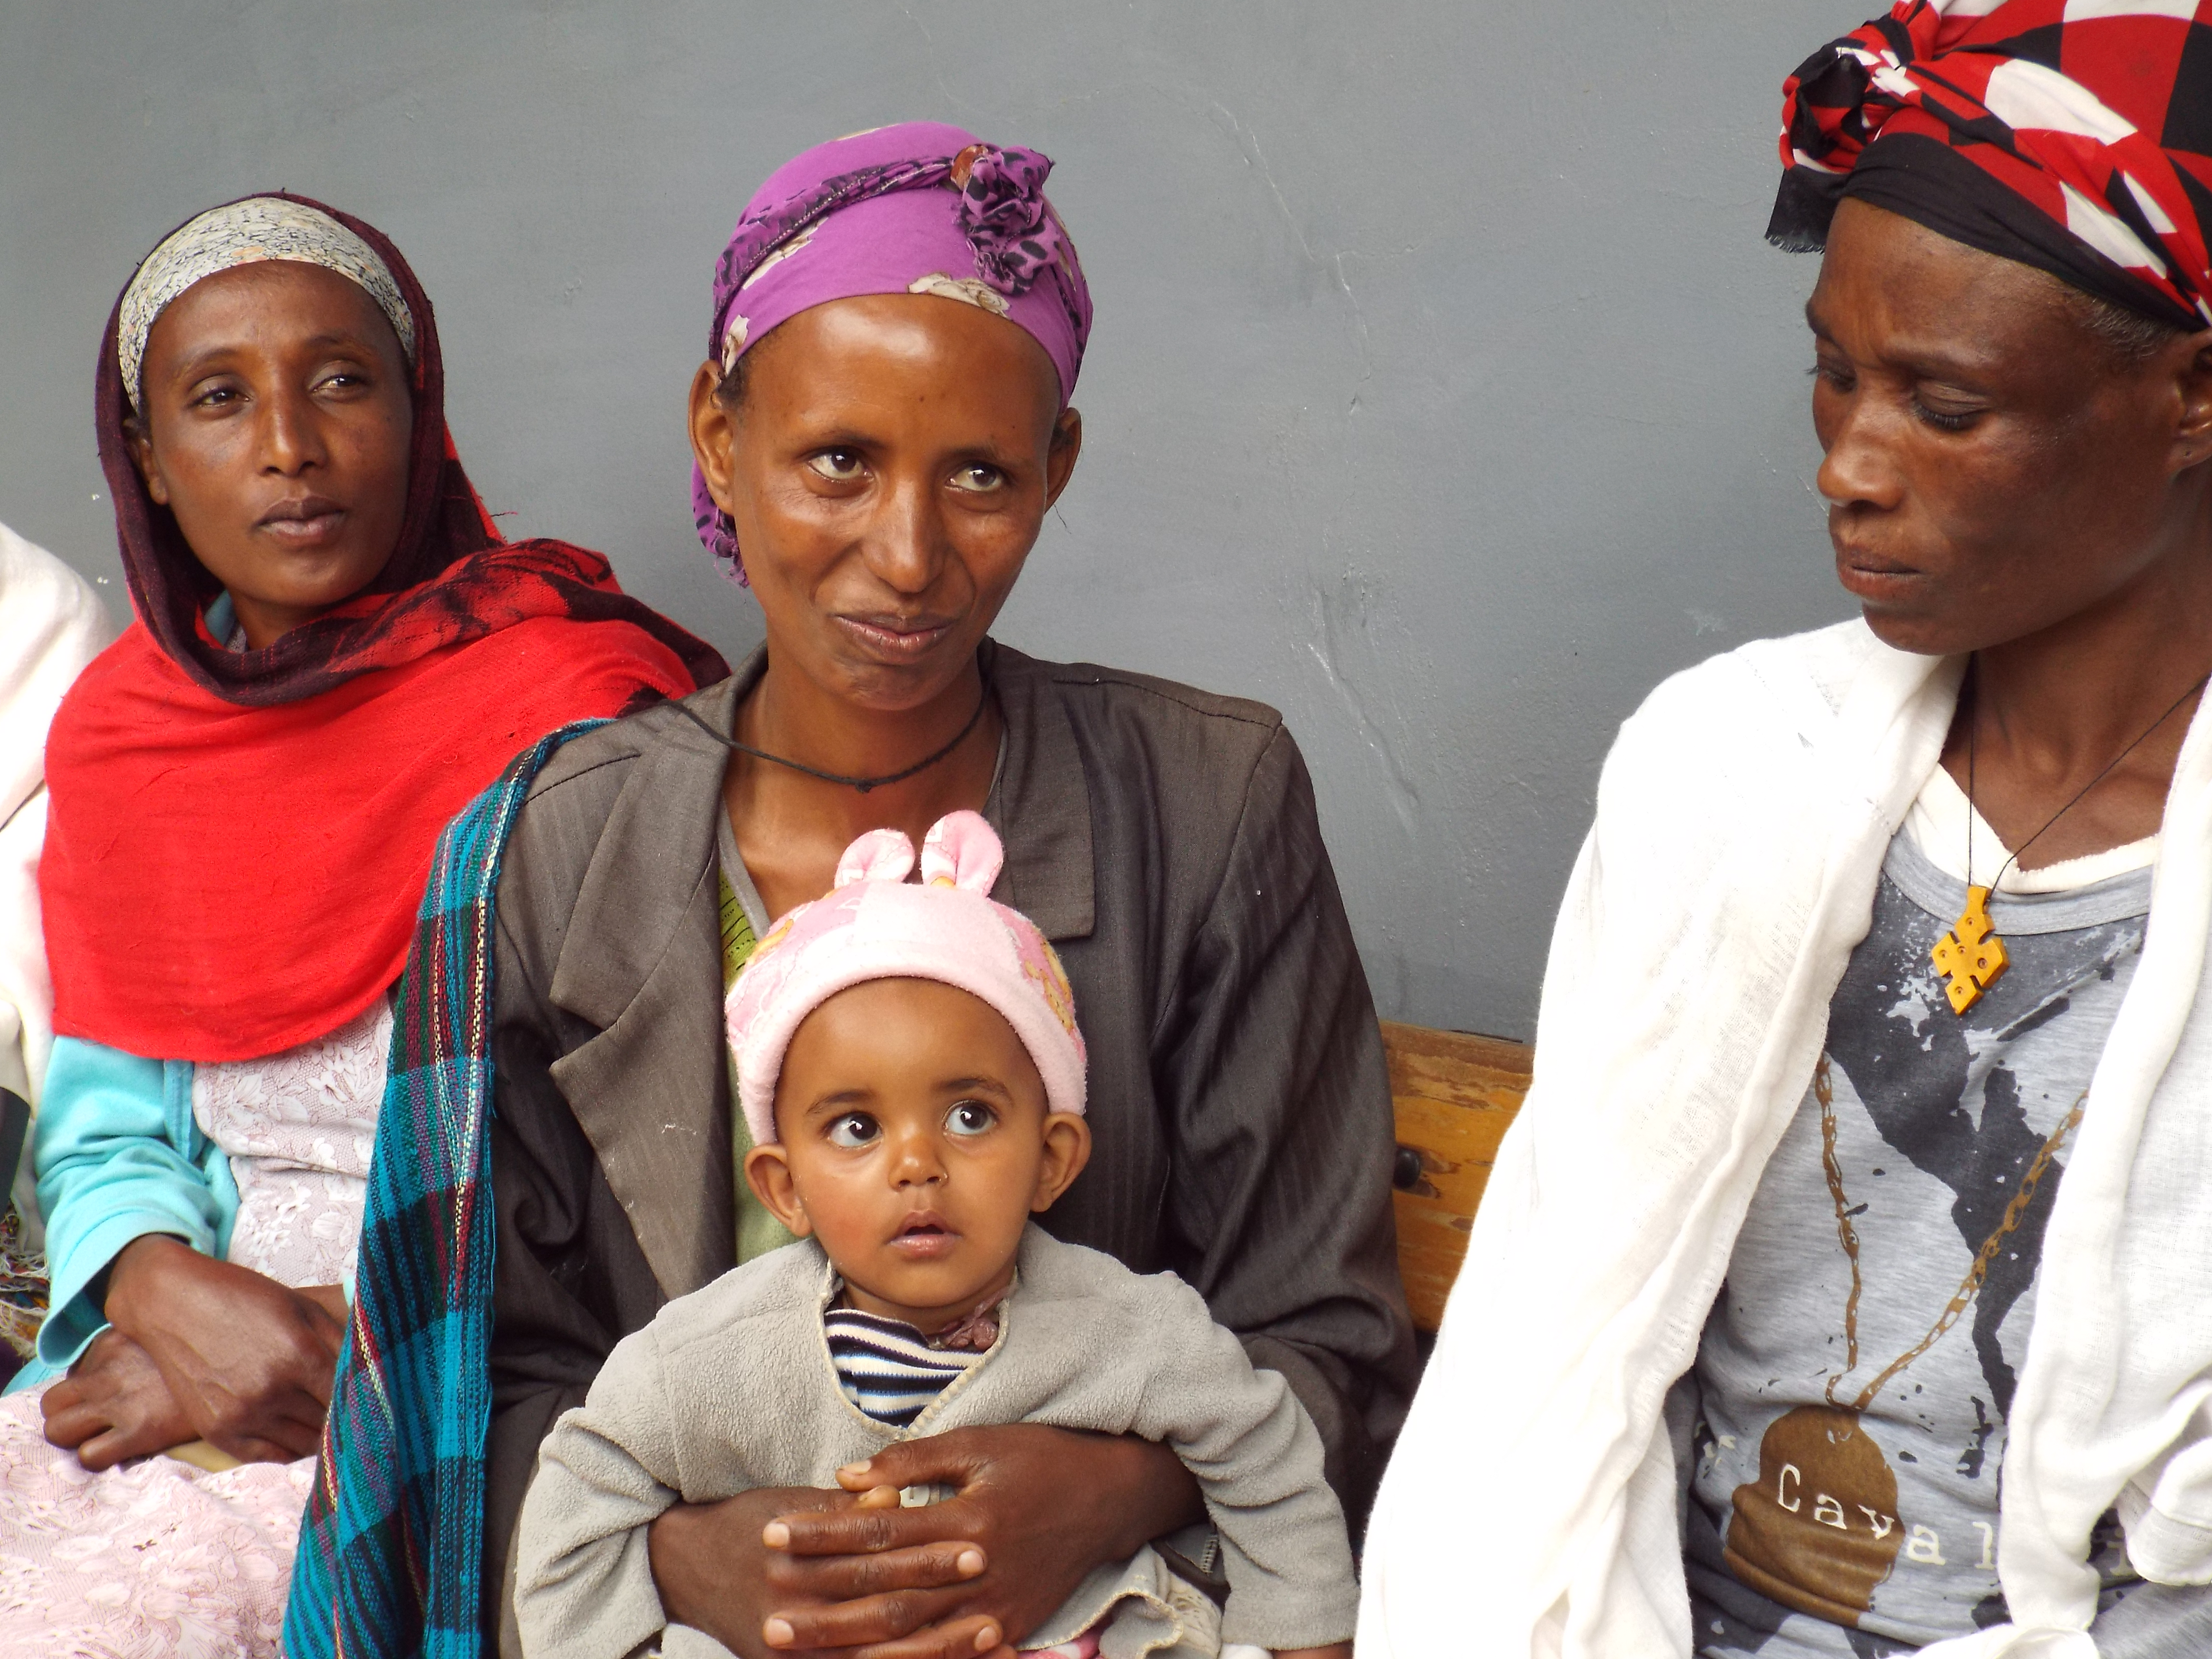

Slide 24
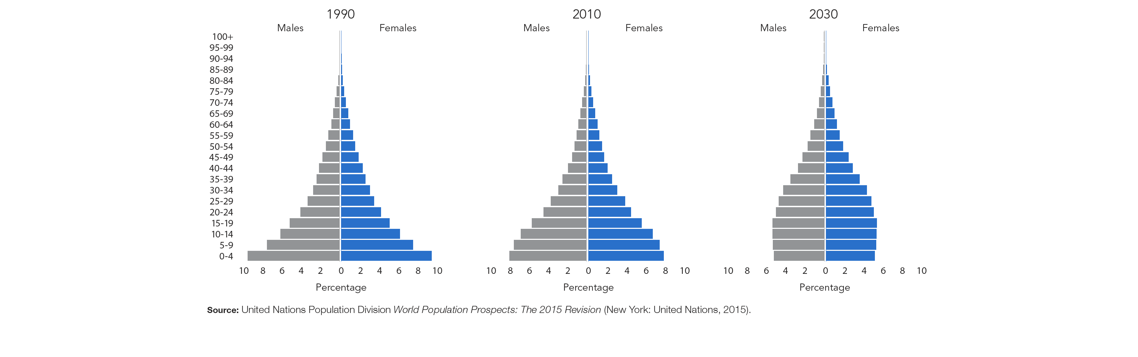
Population Pyramids for Ethiopia in 1990, 2010, and 2030 (projection)

Slide 25
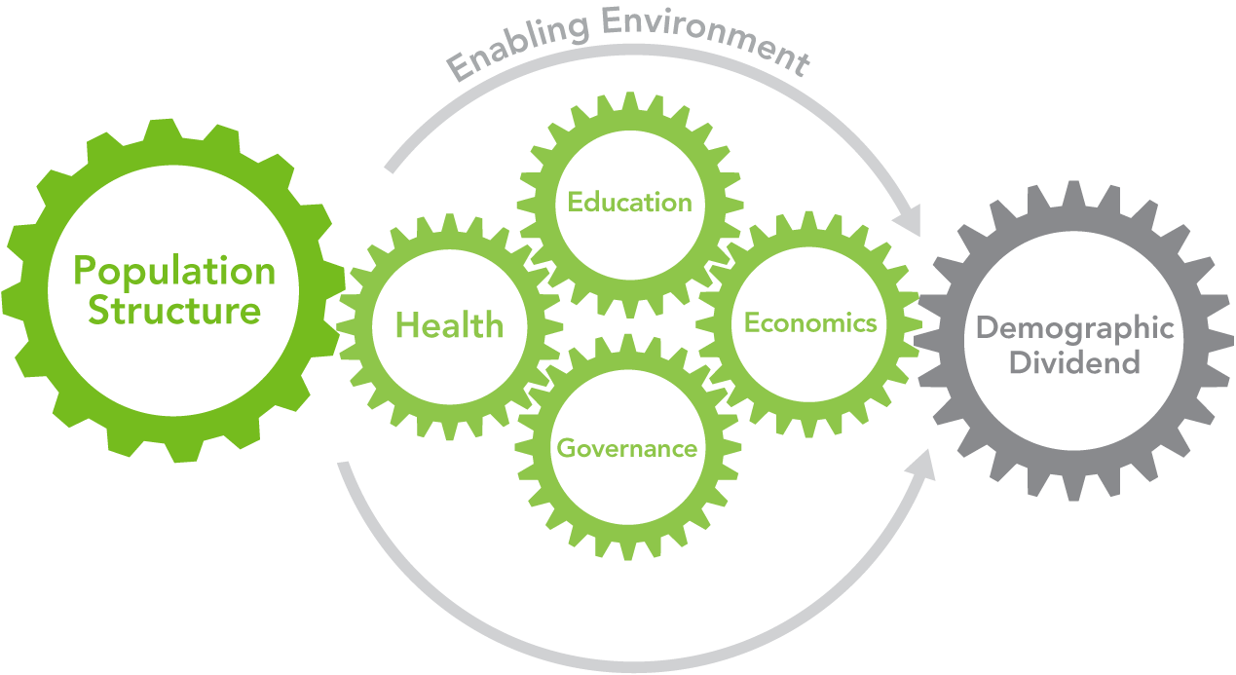
Policy Interventions Facilitating a Demographic Dividend

Slide 26
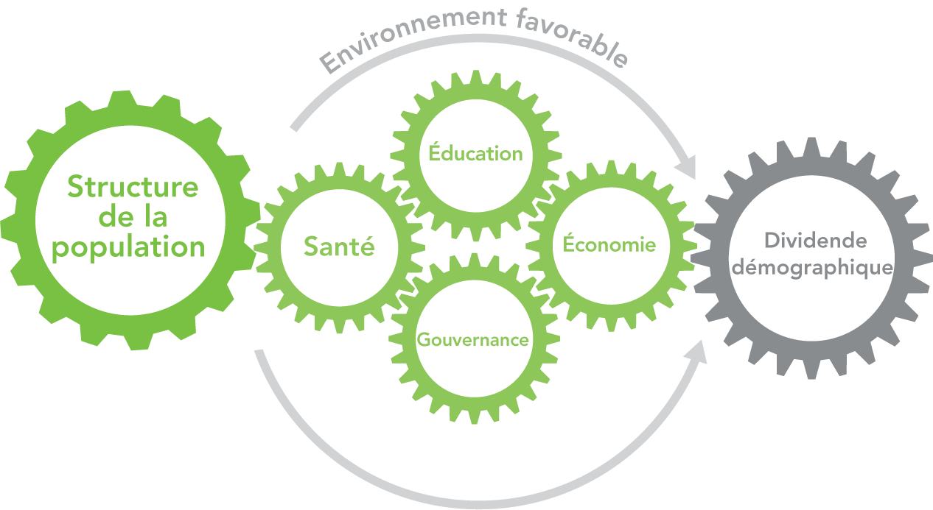
Les actions politiques qui favorisent le dividende démographique

Slide 27
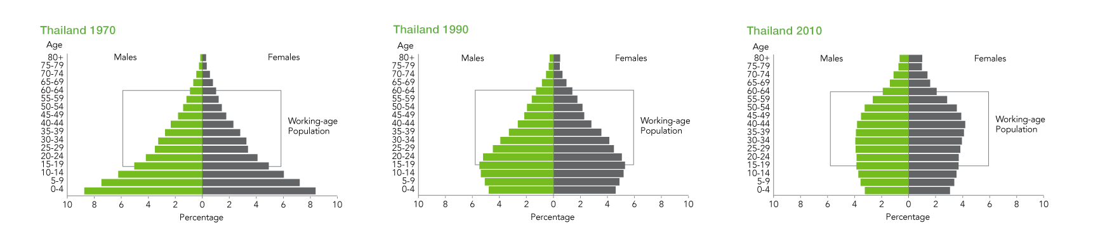
Thailand: Reaping the Dividends of a Demographic Transition
Sources: United Nations Population Division, World Population Prospects: The 2010 Revision, low variant (New York: UNFPA, 2011); and United Nations Population Fund, Impact of Demographic Change in Thailand (Bangkok: UNFPA, 2011).

Slide 28
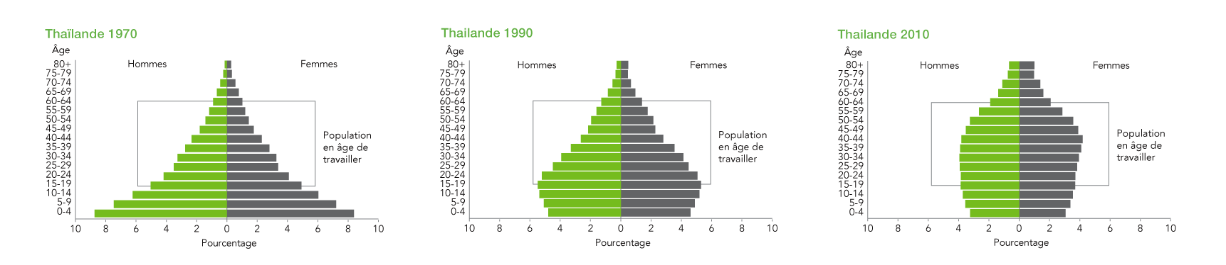
Thaïlande : récolter les dividendes d’une transition démographique
Sources : Division de la population des Nations Unies, World Population Prospects : The 2010 Revision, low variant (New York : UNFPA, 2011) ; et Fonds des Nations Unies pour la population, Impact of Demographic Change in Thailand (Bangkok : UNFPA, 2011).

Slide 29
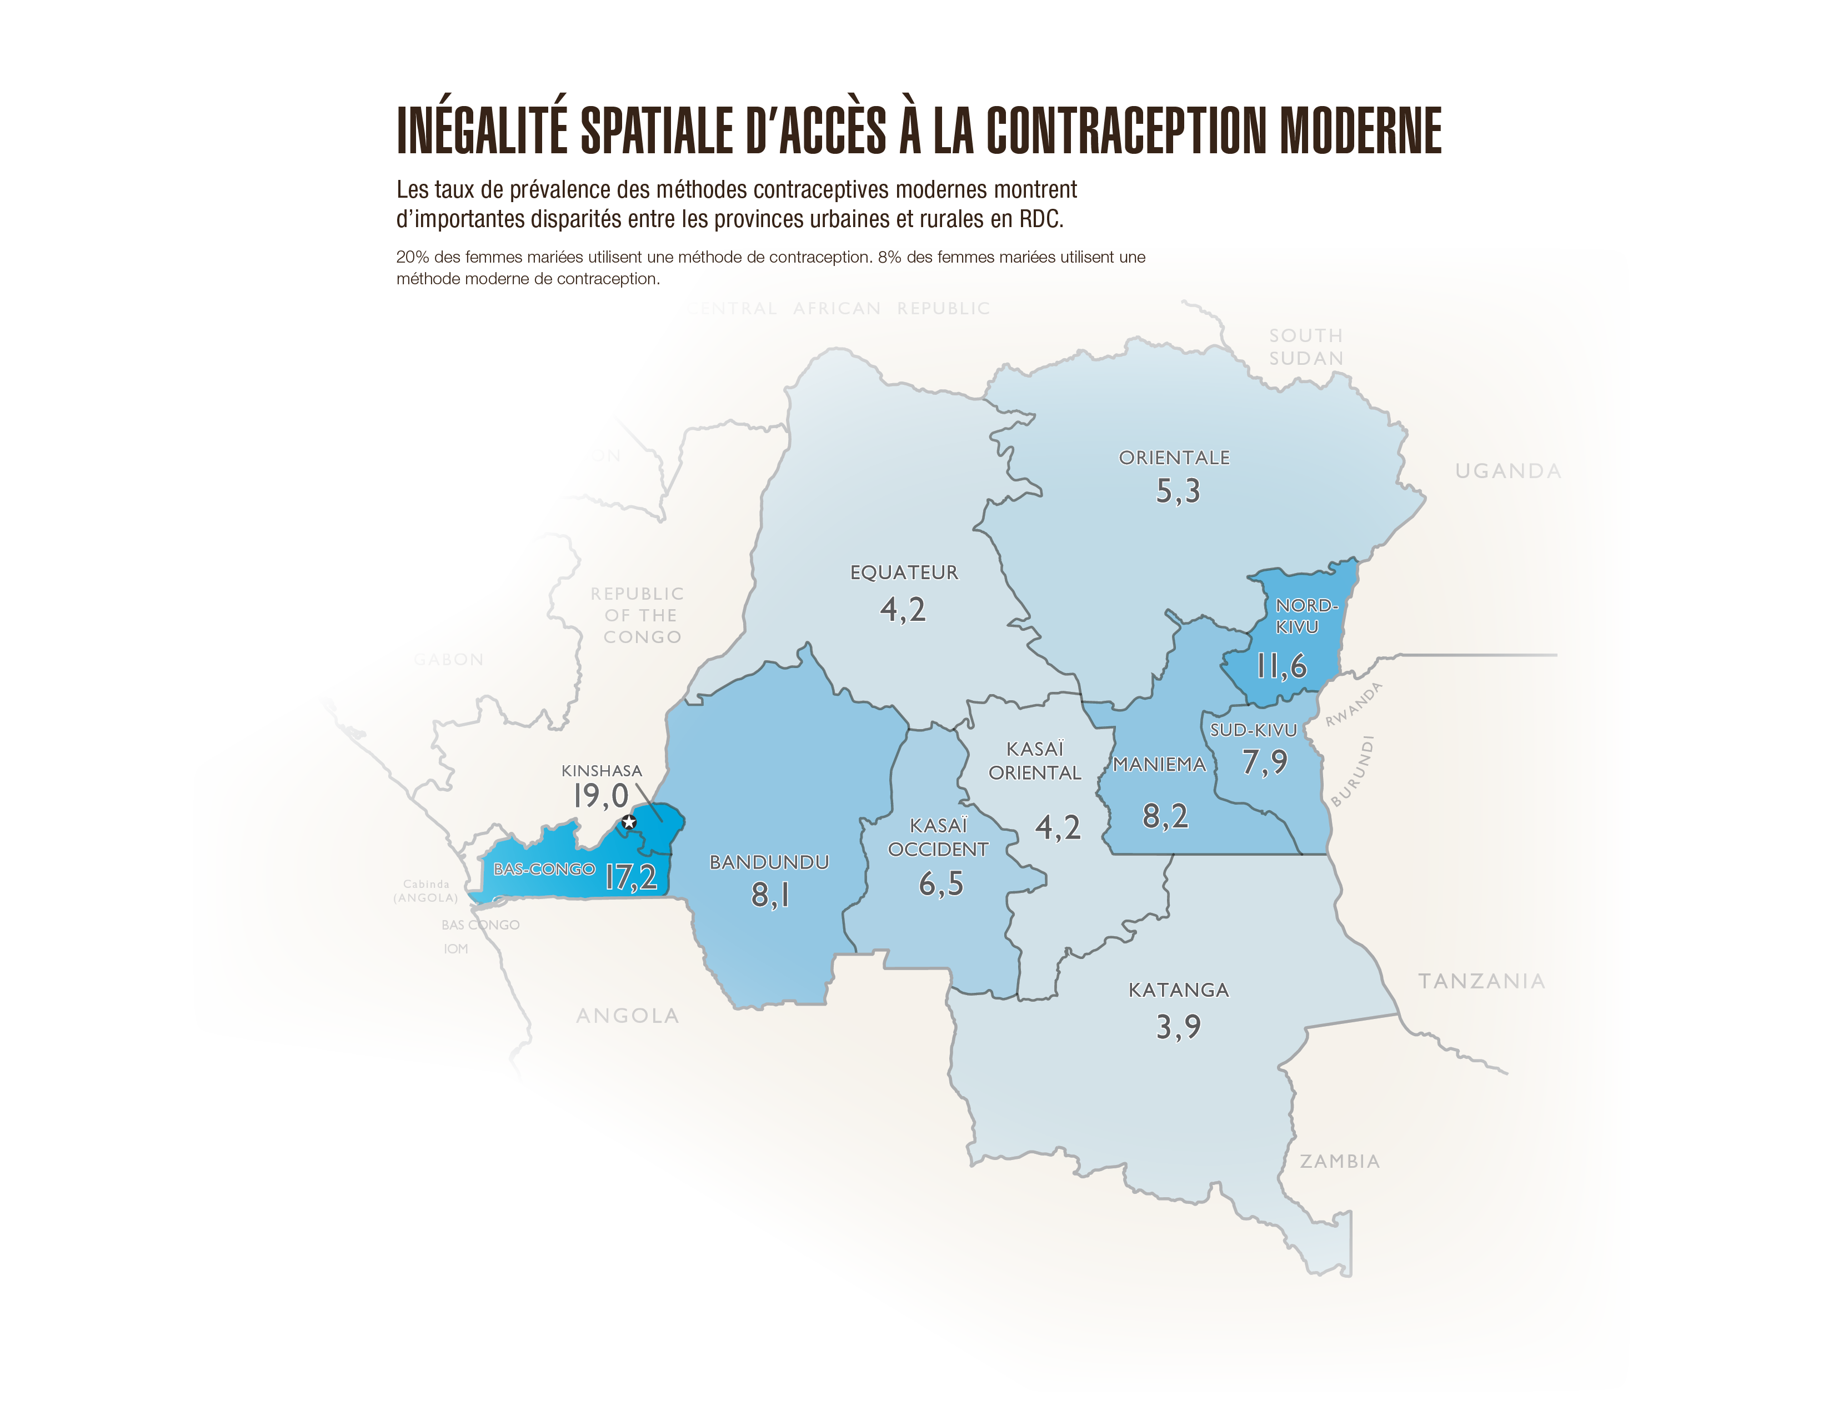

Slide 30
Images used in these slides are taken from the following resources:
Assefa Admassie, Seid Nuru Ali, John F. May, Shelley Megquier, and Scott Moreland, The Demographic Dividend: An Opportunity for Ethiopia’s Transformation (Washington, DC: Population Reference Bureau (PRB), 2015).
James N. Gribble and Jason Bremner, “Achieving a Demographic Dividend,” Population Bulletin 67, no. 2 (Washington, DC: PRB, 2012).
James N. Gribble and Jason Bremner, Challenge of Attaining a Demographic Dividend (Washington, DC: PRB, 2012).
PRB, “Harnessing the Demographic Dividend,” An ENGAGE presentation (Washington, DC: PRB, 2013), accessed at www.prb.org/Multimedia/Video/2013/demographic-dividend-engage.aspx.
PRB and the University of Kinshasa, L’émergence de la République démocratique du Congo: Le role du dividend démographique (Washington, DC: PRB, 2016).
For more information, demographicdividend@prb.org.

