Slide 1




Malawi Population
Data Sheet 2012

Slide 2
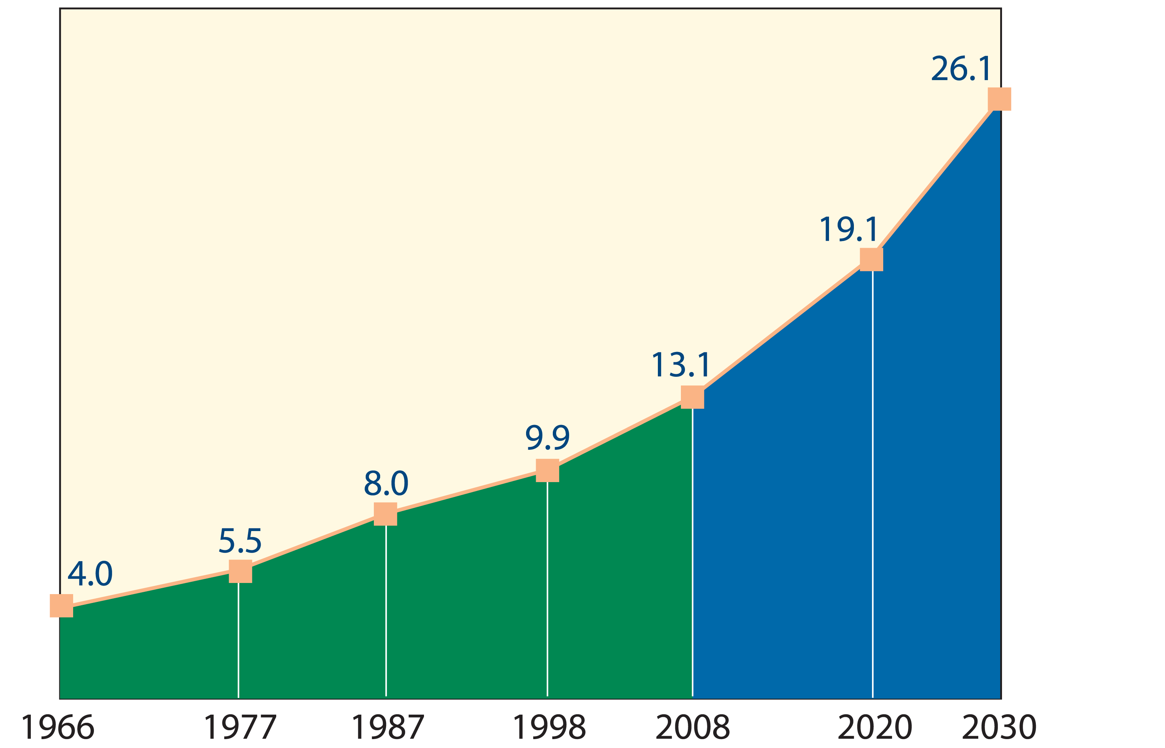
Malawi’s population is growing rapidly
Source: National Statistics Office
Notes:
Malawi’s population is growing rapidly, and in just over 40 years has increased from 4 million people in 1966 to 13.1 million in 2008. Given the high number of births per woman (currently on average 5.7), the population will continue to increase steadily. Even if the total fertility rate declines from the 2010 level of 5.7 to 4.6 by 2020, the population will still grow to 26 million in 2030.

Slide 3
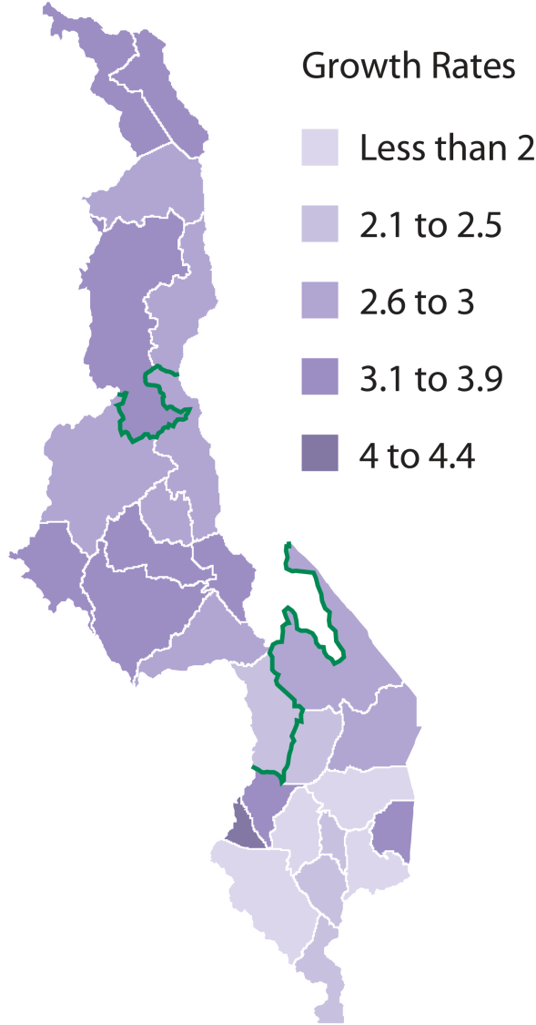
Population is growing fastest in the Northern and Central zones
Source: National Statistics Office,
National Population Census 2008
Notes:
A closer look at the census data provides insight into the distribution and concentration of the population at the district level. Within the country, the annual population growth rates were highest (above the national average of 2.8%) in the districts of the less densely populated Northern and Central regions. Growth has been slower in the districts of the more densely populated Southern region.

Slide 4
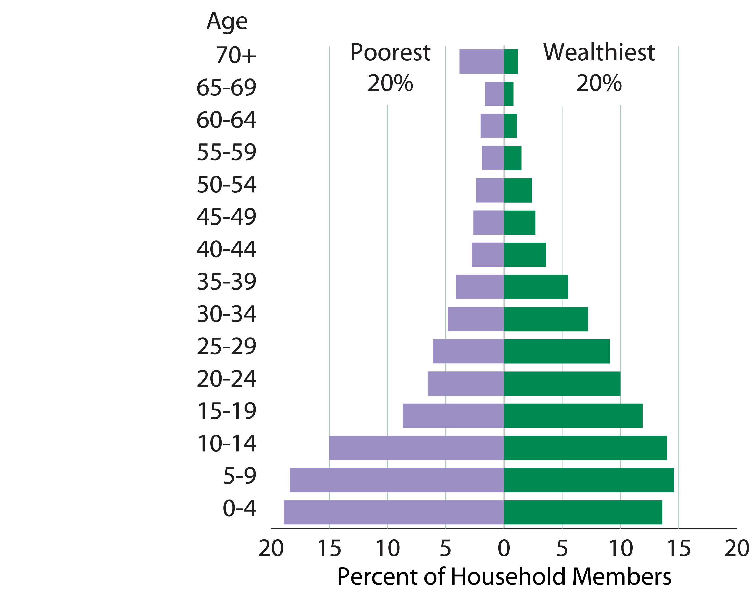
The age structure varies by household wealth
Source: Malawi Demographic and Health Survey, 2010
Notes:
With sustained high fertility over the last decade, the age structure among the poorest 20 percent of the population is extremely youthful. The median age is 13. During the same time period, the wealthiest 20 percent began to experience a fertility decline, increasing the median age of this group to 17.

Slide 5
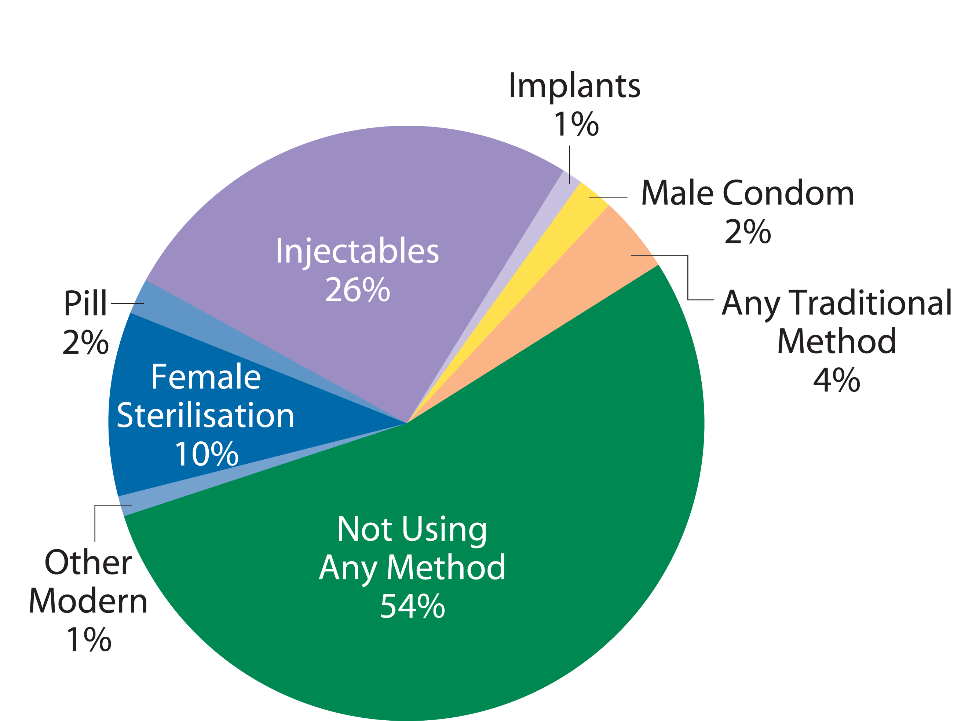
Use of modern contraception is high
Source: Malawi Demographic and Health Survey, 2010
Notes:
Among married women ages 15 to 49, 42 percent use modern family planning methods. More than one out of four married women use injectables, and an additional 10 percent
have opted for female sterilisation. Six percent use other modern methods including the pill, implants, and condoms. Four percent of married women rely on traditional methods,
such as periodic abstinence or withdrawal, to space or limit their births.

Slide 6
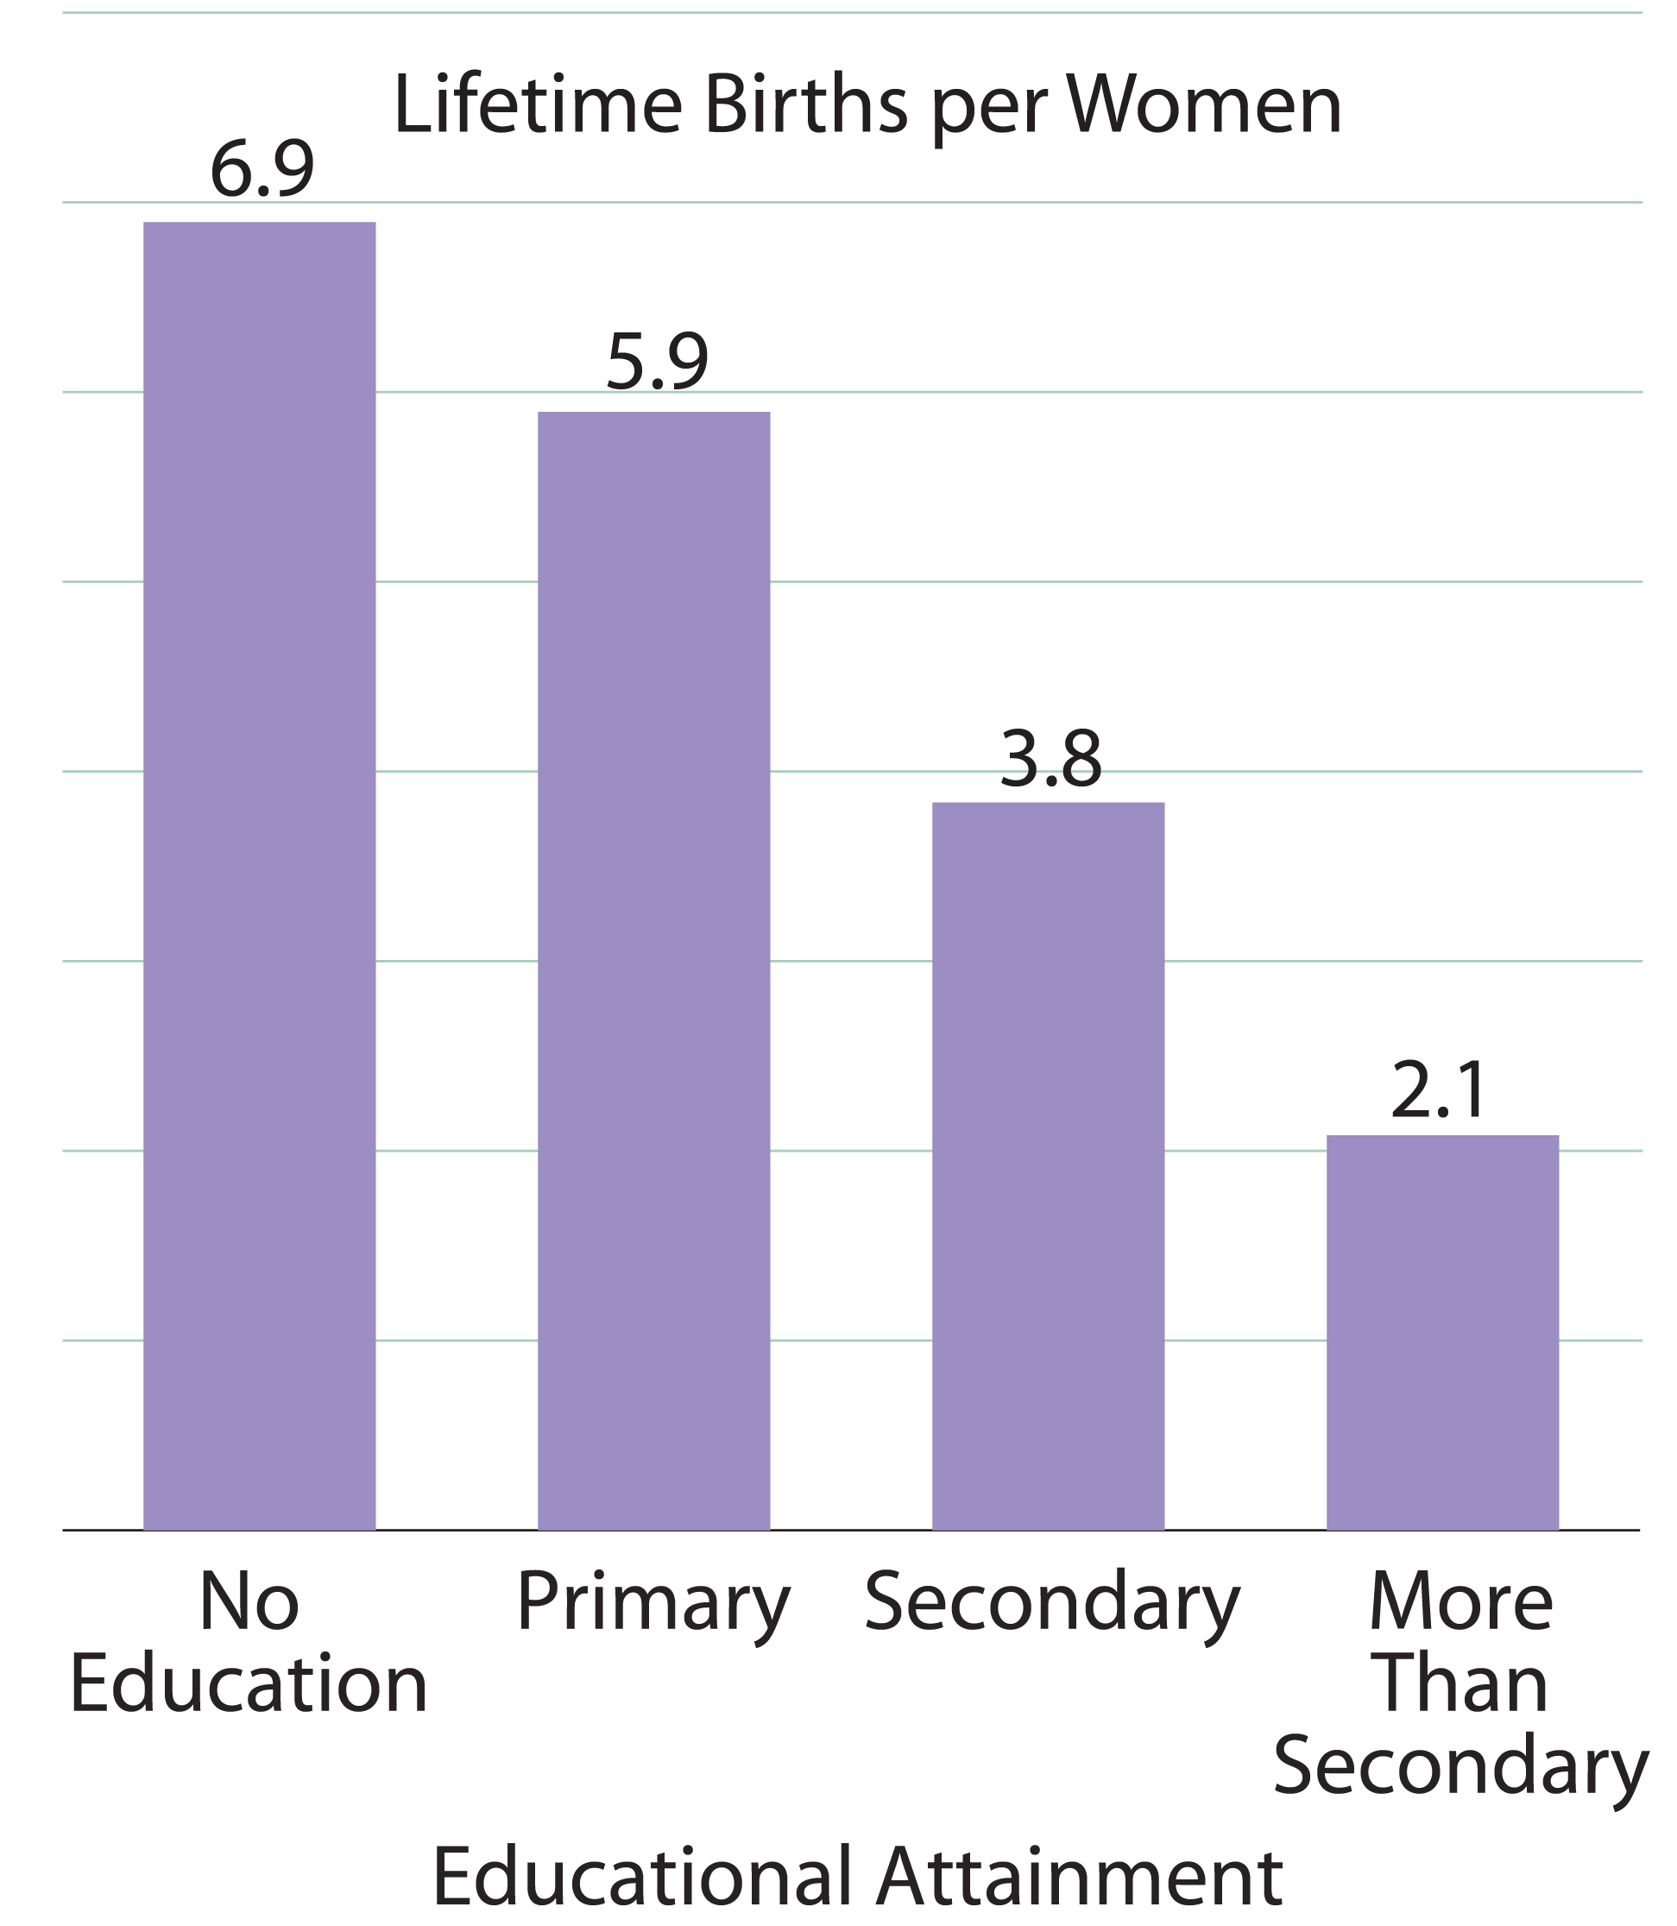
Women with more education have fewer children
Source: Malawi Demographic and Health Survey, 2010
Notes:
Educational attainment and fertility are closely related. Women with higher levels of education tend to have fewer children. Women with no education have an average of
more than three times as many children as women who continued their studies beyond secondary school.

Slide 7
Many young women are married by age 18
Source: Malawi Demographic and Health Survey, 2010
Notes:
Early marriage persists, with little variation in more than a decade. Among young women ages 20 to 24, half were married by age 18. By delaying marriage, young women are more likely to have fewer children and continue their education.

Slide 8
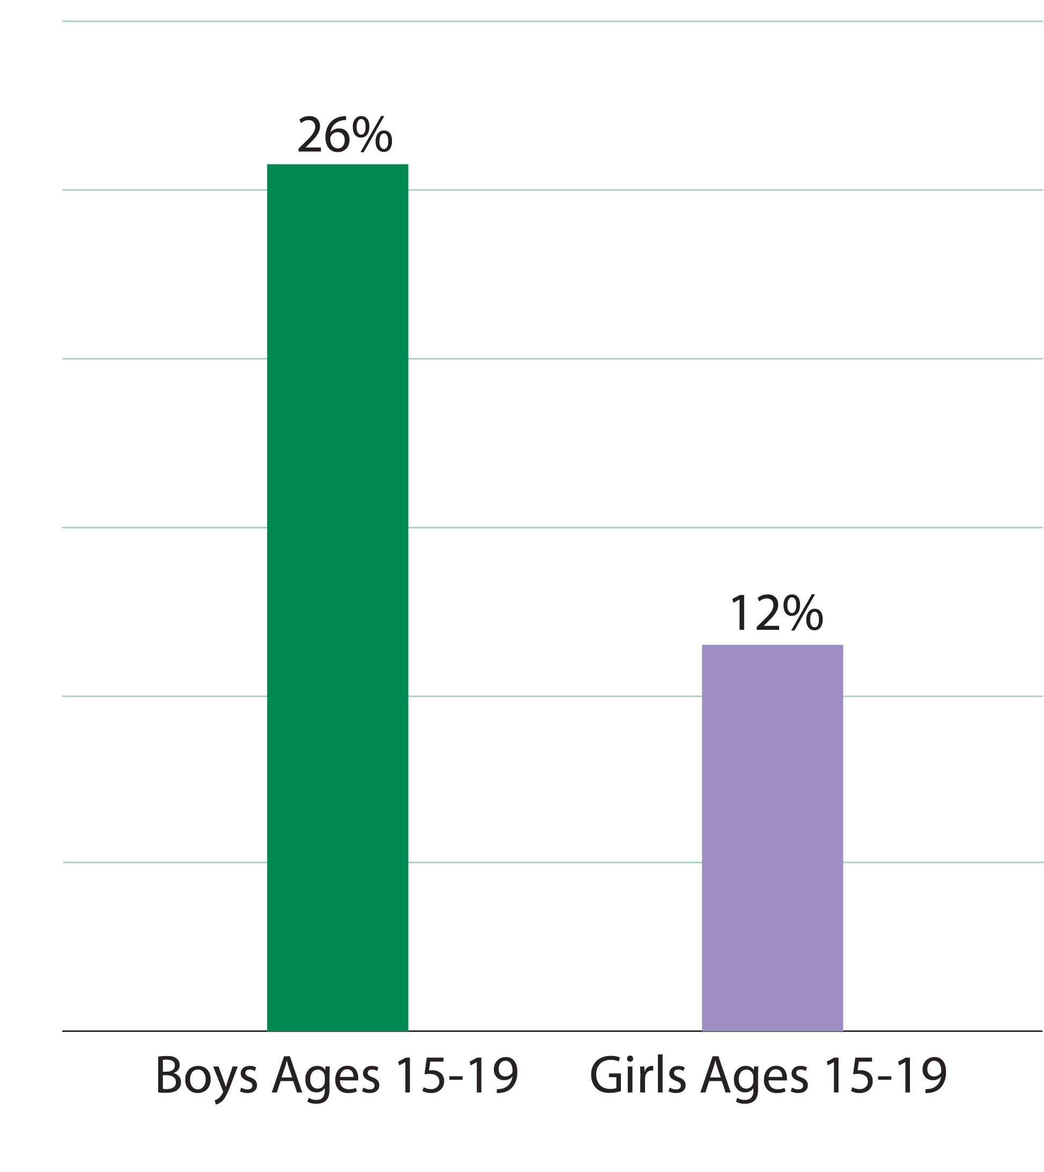
Many adolescents have sex before age 15
Source: Malawi Demographic and Health Survey, 2010
Notes:
More than one in four adolescent boys has had sex before age 15, and are twice as likely to have sex before age 15 as girls. Providing family planning to young people prevents disease and unintended pregnancy, and promotes a healthy transition to adulthood. Given the high prevalence of HIV, it is important to reach young people with information about how to avoid infection.

Slide 9
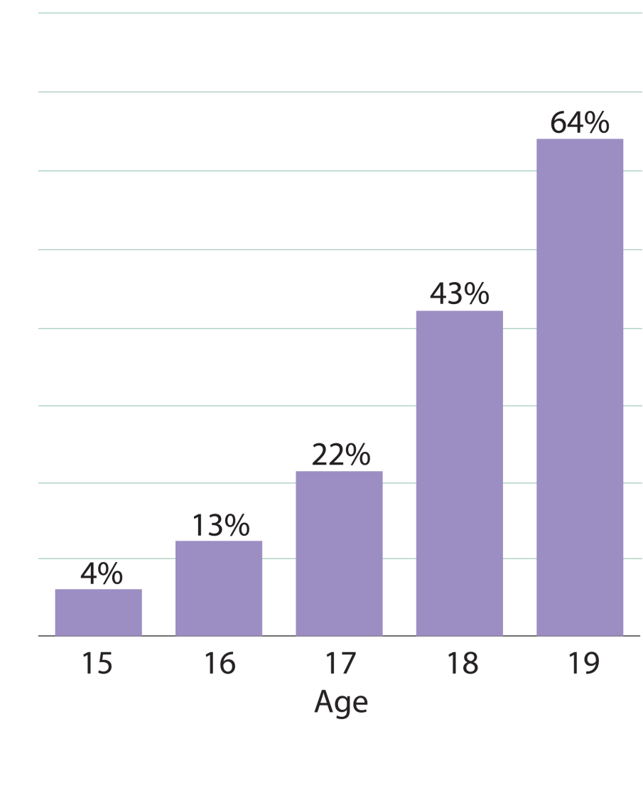
Many adolescent women have begun childbearing by age 18
Source: Malawi Demographic and Health Survey, 2010
Notes:
In Malawi, a child is legally defined as any person under the age of 18. More than 1 in 5 adolescent girls have begun bearing children by age 17. Early childbearing is a major health concern because of the increased risks of death and disability to both mother and child during pregnancy and childbirth.

Slide 10
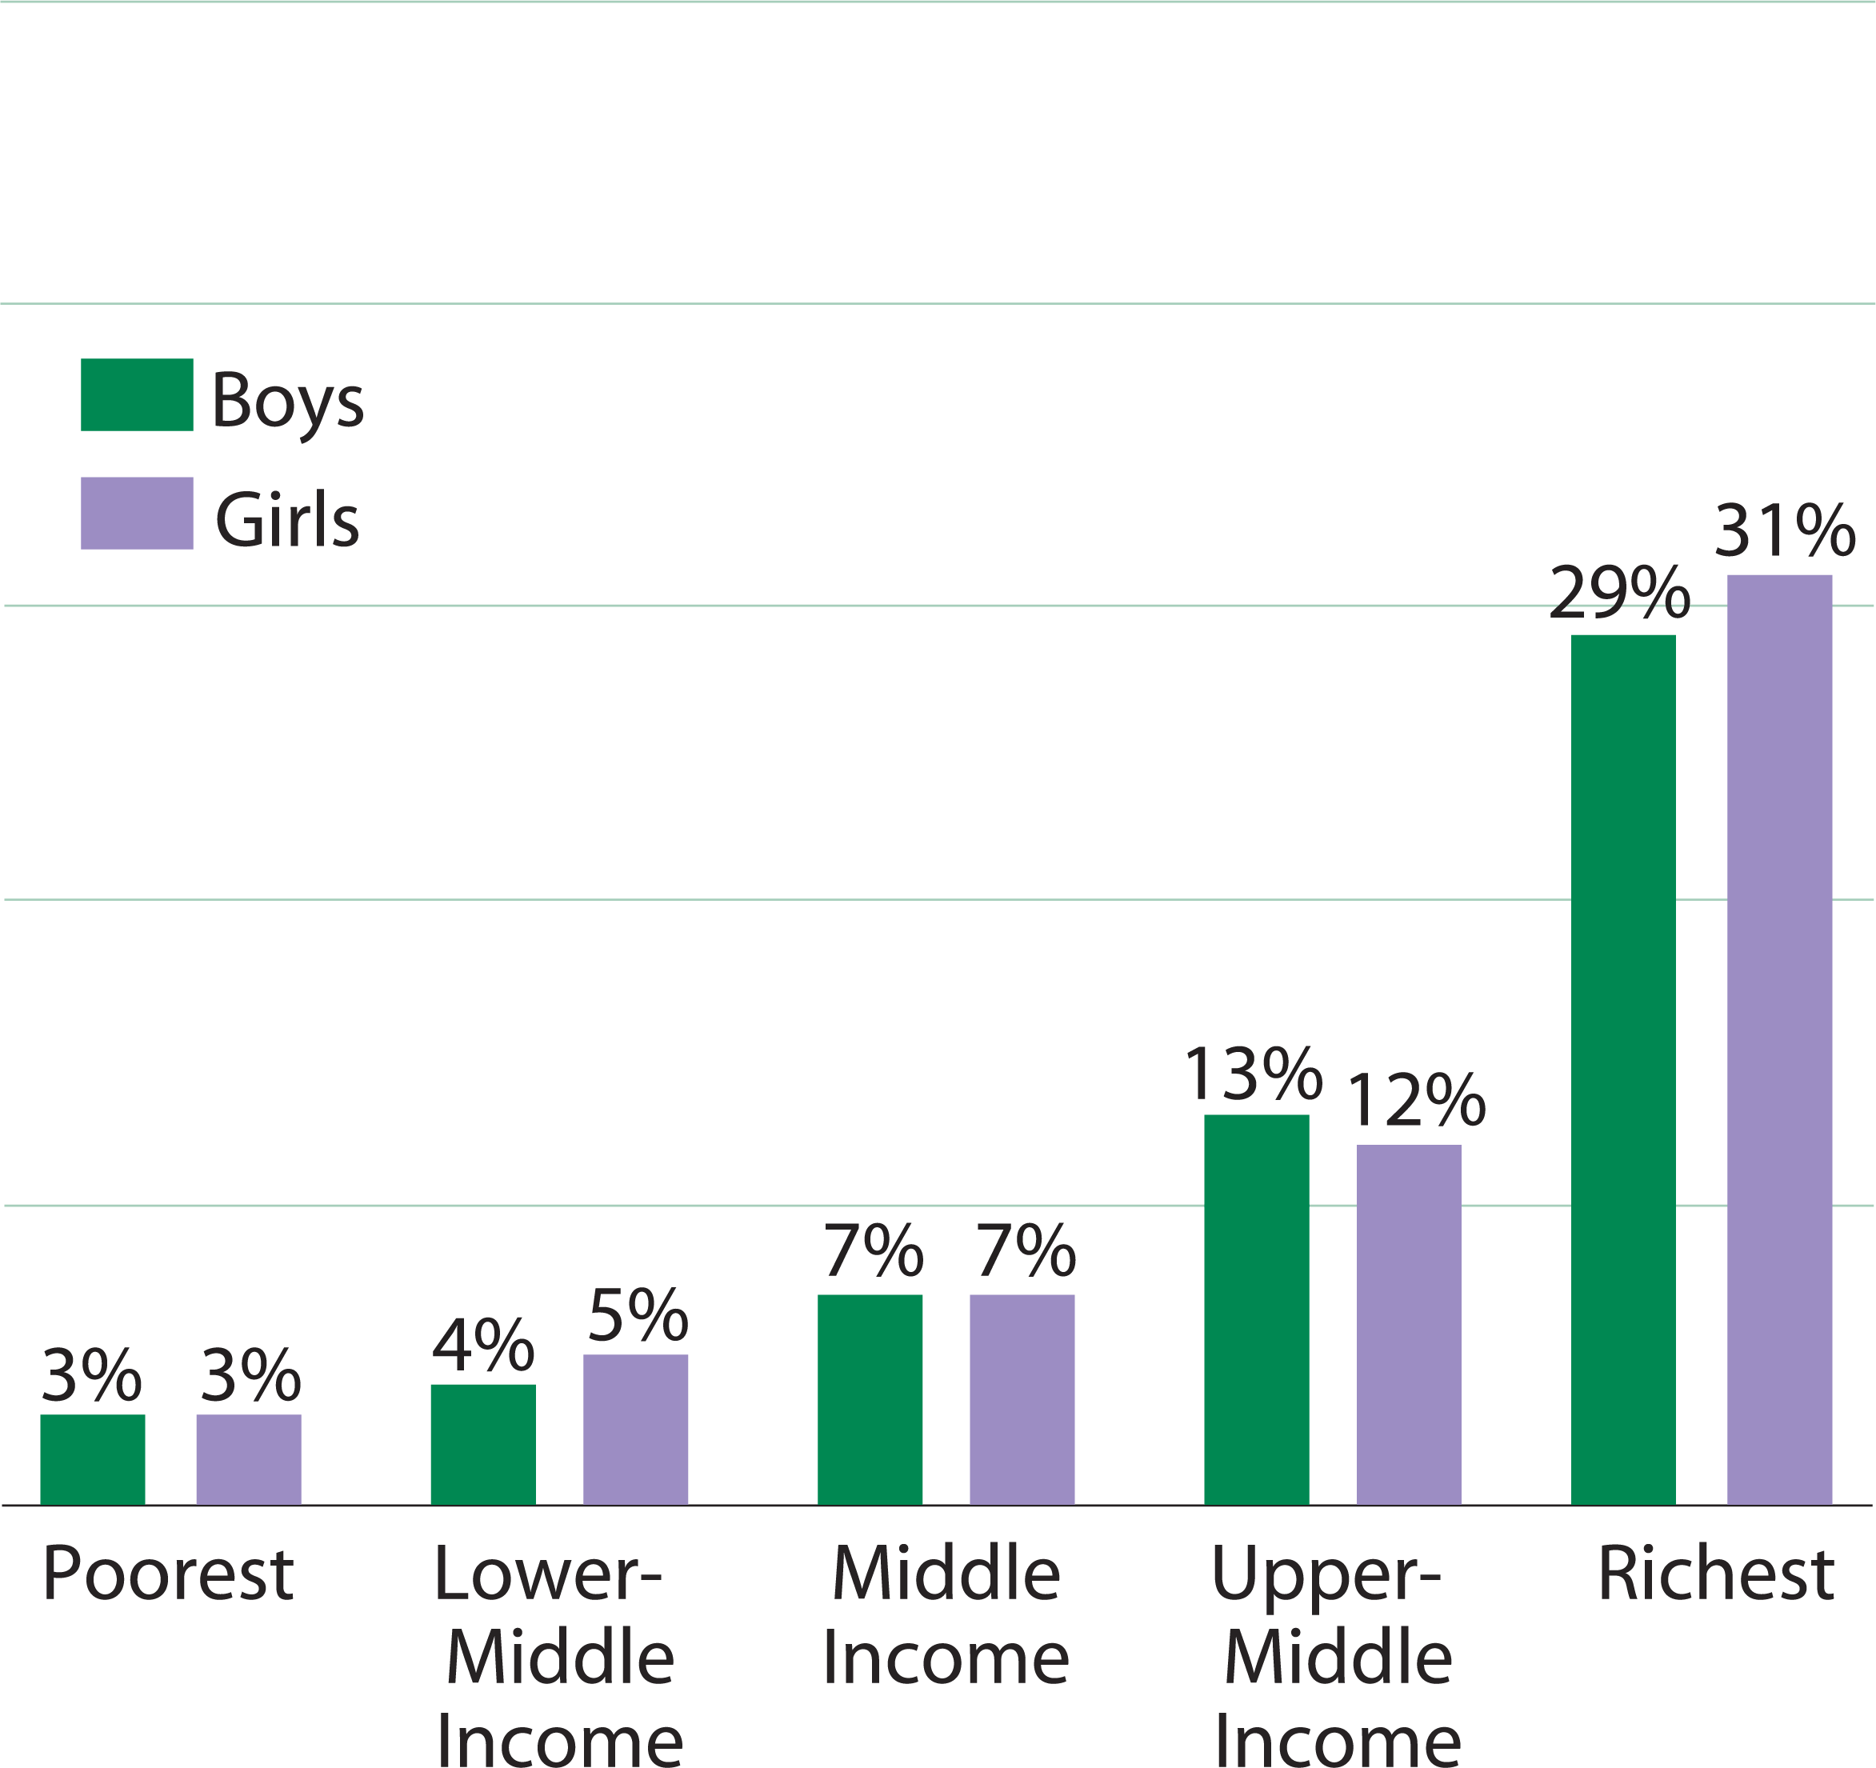
Secondary school varies widely by income level
Source: Malawi Demographic and Health Survey, 2010
Notes:
While secondary school attendance varies little between boys and girls, there is a wide variation between income levels. Because education plays a key role in shaping an
individual’s lifestyle and status in society, all students should be encouraged to continue their studies. Students who stay in school longer tend to delay marriage, have smaller
families, and be better informed about health-related behaviors.

